Slide 1
Group Member Muhammad Asim 16-Arid-1200 Atif Mehmood 16-arid-1158
IOT Based Patient Health Monitoring System

Slide 2
Literature Review
Internet of Things(IoT)Based Smart Healthcare System(2018)
The entire system is connected using ESP8266 Wi-Fi module. The details regarding the medicines should be entered through the application. The working of the medicine box starts once the details have been entered by the user including the timing and the slot from which the medicine has to be consumed. The microcontroller will receive information through the application and will function according to the data provided by the user. According to the activity of the patient the medicine box will then generate data and this data will be sent to the application through internet. This information will be displayed on the app in the form of notifications. [1]

Slide 3
Literature Review
2. IOT Patient Health Monitoring System(2017).
This system uses fall detection and sleep pattern analysis. The sensors utilized as a part of this project are Accelerometer and Gyroscope (MPU6050), Heart beat sensor, Body temperature sensor, and blood oxygen level (MAX30100), and Proximity sensor (KY032). These sensors work autonomously of each other. The measured reading from the sensor is broke down for the patient and is made accessible to the specialist or to any concerned individual in the type of the web or smart phones. s. The interfacing between the equipment and the product part is done on the stage of AWS IoT. [2]

Slide 4
Literature Review
3. Healthcare Monitoring System and transforming Monitored data into Real time Clinical Feedback based on IoT using Raspberry Pi(2019)
In this system MLX90614 contactless sensor is used for temperature monitoring, A0813 is used for monitoring pulse rate while AD8232 helps in monitoring ECG of patients. Whole data is sensed and collected by Arduino board which then fed to Raspberry pi and transferred to server through Wi-Fi dongle. The dynamic webpage is updating every two minutes after receiving data from server. Doctor can diagnose patients’ condition by analysing data shown on app. [3]

Slide 5
Literature Review
Challenges Facing Health Monitoring IoT in 2019
There are vast possibilities for the use of IoT devices in health care related to vulnerabilities. As IOT device use increases, so does the number of ways hackers could infiltrate the system and mine for the most valuable data. Once a new risk has been identified, hackers could learn how the connected medical device operates by entering the system and reading its error logs. Knowledge gained by hackers could make it easier to break into a hospital network or make devices publish incorrect readings that influence patient care.[4]

Slide 6
Critical Analysis from Literature Review
In existing system there are major problem is security. Patient cannot communicate with doctor and doctor cannot prescribe medicine to patient. In our system we are using asymmetric cryptography for security between IOT device and server. We build a complete web panel and android app for doctor and patient with new tools and language. Through android app doctor and patient can communicate in secure network. Doctor can monitor patient health and prescribe medicine.

Slide 7
References :
https://www.researchgate.net/publication/328093877_Internet_of_ThingsIoTBased_Smart_Healthcare_System
https://www.researchgate.net/publication/322542647_Iot_Patient_Health_Monitoring_System
https://www.researchgate.net/profile/Kamran_Zeb/publication/332422799_Healthcare_Monitoring_System_and_transforming_Monitored_data_into_Real_time_Clinical_Feedback_based_on_IoT_using_Raspberry_Pi/links/5d22f8ff299bf1547ca1bcf5/Healthcare-Monitoring-System-and-transforming-Monitored-data-into-Real-time-Clinical-Feedback-based-on-IoT-using-Raspberry-Pi.pdf
https://www.iotforall.com/5-challenges-facing-iot-healthcare-2019/

Slide 8
Functional Requirements: Web panel
1 | Title: | Add new Doctor
Description: |  | Admin can add doctor details into database
Input: |  | Click on add doctor button and then input doctor name, father name, address, qualification, phone number, date, specialization.
Output: |  | Display doctor successfully added message.
Pre-condition: |  | Open All doctor list page .
Post-condition: |  | Information should save in to the database and generate id.
Action: |  | Input all values in required field and click “Add new doctor” button.
Destination: |  | All doctor list page.

Slide 9
Delete doctor
2 | Title: | Delete doctor
Description: |  | Admin can delete doctor by clicking on delete button
Input: |  | Click on delete doctor button.
Output: |  | Display doctor successfully deleted message.
Pre-condition: |  | Open see doctor page.
Post-condition: |  | Information should delete from database.
Action: |  | Click on see doctor page and then click on “delete doctor” button.
Destination: |  | All list of doctor page.

Slide 10
See All doctors and search
3 | Title: | See All doctors and search
Description: |  | Admin can search and see all doctor list and details by click on button
Input: |  | Click on see all doctor button and search doctor by typing doctor name in textbox
Output: |  | Display doctor list on page and search result display on screen.
Pre-condition: |  | Open doctor list page.
Post-condition: |  | All doctor list should retrieved from the database and display on page and
Action: |  | Click on “see all doctor” button and search.
Destination: |  | same page.

Slide 11
See Doctor Details
4 | Title: | See Doctor Details
Description: |  | Admin can see doctor details. e.g. personal details and assigned patient list by clicking on see doctor button.
Input: |  | Click on see doctor details button.
Output: |  | Display doctor details on next page.
Pre-condition: |  | Open all doctor list page.
Post-condition: |  | Doctor details page open.
Action: |  | Click on see doctor details page.
Destination: |  | Doctor details page.

Slide 12
See all patients categorized by disease or doctor
5 | Title: | See all patients categorized by disease or doctor
Description: |  | Admin can see patient list filter on disease or doctor
Input: |  | Click on see all patient button
Output: |  | Display patients category wise.
Pre-condition: |  | Open all patient list page.
Post-condition: |  | Patient must filter by category wise.
Action: |  | Click on filter button.
Destination: |  | Same page.

Slide 13
Delete Patient
6 | Title: | Delete Patient
Description: |  | Admin can delete patient by clicking on delete button
Input: |  | Click on delete patient button.
Output: |  | Display patient successfully deleted message.
Pre-condition: |  | Open see patient page.
Post-condition: |  | Information should delete from database.
Action: |  | Click on see patient page and then click on “delete patient” button.
Destination: |  | All list of patient page.

Slide 14
Add new Patient
7 | Title: | Add new Patient
Description: |  | Admin can add patient details into database
Input: |  | Click on add patient button and then input patient name, father name, address, phone number, date, disease, device id.
Output: |  | Display patient successfully added message.
Pre-condition: |  | Open All patient list page .
Post-condition: |  | Information should save in to the database and generate id.
Action: |  | Input all values in required field and click “Add new patient” button.
Destination: |  | All patient list page.

Slide 15
Assign doctor to patient
8 | Title: | Assign doctor to patient
Description: |  | Admin can assign doctor to patient by clicking a assign doctor button and select doctor and click add button.
Input: |  | Select doctor
Output: |  | Display doctor details that assign to patient on patient details page.
Pre-condition: |  | Open patient details page.
Post-condition: |  | Doctor must assigned to patient
Action: |  | Perform all action mention in Input and click “Add ” button.
Destination: |  | Patient details page.

Slide 16
Emergency Alert Notification
9 | Title: | Emergency Alert Notification
Description: |  | Admin get alert if patient health is critical.
Input: |  | No input
Output: |  | Pop up notification display on screen.
Pre-condition: |  | Admin must login on web panel.
Post-condition: |  | Alert notification is must display on web panel.
Action: |  | Click on notification and see patient health status and location.
Destination: |  | Patient details page

Slide 17
Show patient details
10 | Title: | Show patient details
Description: |  | Admin can see patient personal information and location and heartbeat, temperature, ECG on graph.
Input: |  | Select patient and open patient details page.
Output: |  | Display location and heartbeat, temperature and ECG on graph.
Pre-condition: |  | Open patient details page
Post-condition: |  | All correct data display on screen.
Action: |  | None
Destination: |  | Patient details page.

Slide 18
Login
11 | Title: | Login
Description: |  | Admin can login using email address and password.
Input: |  | Email address, password.
Output: |  | Display user successfully logged in.
Pre-condition: |  | Open web panel.
Post-condition: |  | Must open dashboard page.
Action: |  | Input all values in required field and click “login” button.
Destination: |  | Dashboard page.

Slide 19
Patient Android App Login
12 | Title: | Login
Description: |  | Patient can login using phone number and password.
Input: |  | Phone number, password.
Output: |  | Display user successfully logged in.
Pre-condition: |  | Open app.
Post-condition: |  | Must patient details page.
Action: |  | Input all values in required field and click “login” button.
Destination: |  | Patient details page.

Slide 20
Show patient details
13 | Title: | Show patient details
Description: |  | Patient can see his personal information and heartbeat, temperature, ECG on graph.
Input: |  | open patient details page.
Output: |  | Display location and heartbeat, temperature and ECG on graph.
Pre-condition: |  | Open patient details page
Post-condition: |  | All correct data display on screen.
Action: |  | None
Destination: |  | Patient details page.

Slide 21
See All doctors and search
3 | Title: | See All doctors and search
Description: |  | Patient can search and see all doctor list and details by click on button
Input: |  | Click on see all doctor button and search doctor by typing doctor name in textbox
Output: |  | Display doctor list on page and search result display on screen.
Pre-condition: |  | Open doctor list page.
Post-condition: |  | All doctor list should retrieved from the database and display on page and
Action: |  | Click on “see all doctor” button and search.
Destination: |  | same page.

Slide 22
Emergency Alert Notification
14 | Title: | Emergency Alert Notification
Description: |  | Patient get alert if his health is critical.
Input: |  | No input
Output: |  | Pop up notification display on screen.
Pre-condition: |  | Patient must login on app.
Post-condition: |  | Alert notification is must display on mobile.
Action: |  | Click on notification and see his health status.
Destination: |  | Patient details page

Slide 23
Send message to doctor
15 | Title: | Send message to doctor
Description: |  | Patient can send message to doctor and take advice.
Input: |  | Enter message
Output: |  | Message sent successfully message display on screen.
Pre-condition: |  | Open chat page.
Post-condition: |  | Message must sent to required doctor.
Action: |  | Enter message and click send button.
Destination: |  | Same page.

Slide 24
See all medicine prescriptions list (prescribe by doctor )
16 | Title: | See all medicine prescriptions list (prescribe by doctor )
Description: |  | Patient can see prescriptions list.
Input: |  | Click on see all prescriptions button
Output: |  | Display prescriptions list on page.
Pre-condition: |  | Open all prescriptions list page.
Post-condition: |  | Show all prescriptions related to patient.
Action: |  | none.
Destination: |  | Same page.

Slide 25
Doctor Android App Login
17 | Title: | Login
Description: |  | Doctor can login using phone number and password.
Input: |  | Phone number, password.
Output: |  | Display user successfully logged in.
Pre-condition: |  | Open app.
Post-condition: |  | Must all patient page.
Action: |  | Input all values in required field and click “login” button.
Destination: |  | All patient page.

Slide 26
See All Patient and search
3 | Title: | See All Patient and search
Description: |  | Doctor can search and see all patient list and details by click on button
Input: |  | Click on see all patient button and search patient by typing patient name in textbox
Output: |  | Display patient list on page and search result display on screen.
Pre-condition: |  | Open doctor list page.
Post-condition: |  | All patient list should retrieve from the database and display on page and
Action: |  | Click on “see all patient” button and search.
Destination: |  | same page.

Slide 27
Emergency Alert Notification
18 | Title: | Emergency Alert Notification
Description: |  | Doctor get alert if patient health is critical.
Input: |  | No input
Output: |  | Pop up notification display on screen.
Pre-condition: |  | Doctor must login on app.
Post-condition: |  | Alert notification is must display on mobile.
Action: |  | Click on notification and see his health status.
Destination: |  | Patient details page

Slide 28
19 | Title: | Show patient details
Description: |  | Doctor can see patient personal information, location and heartbeat, temperature, ECG on graph.
Input: |  | open patient details page.
Output: |  | Display location and heartbeat, temperature and ECG on graph.
Pre-condition: |  | Open patient details page
Post-condition: |  | All correct data display on screen.
Action: |  | None
Destination: |  | Patient details page.

Slide 29
Send message to Patient
20 | Title: | Send message to Patient
Description: |  | Doctor can send message to patient and give advice.
Input: |  | Enter message
Output: |  | Message sent successfully message display on screen.
Pre-condition: |  | Open chat page.
Post-condition: |  | Message must sent to required patient.
Action: |  | Enter message and click send button.
Destination: |  | Same page.

Slide 30
See medicine prescriptions list patient wise
21 | Title: | See medicine prescriptions list patient wise
Description: |  | Doctor can see prescriptions list patient wise.
Input: |  | Click on see prescriptions button and select patient
Output: |  | Display selected patient prescriptions list on page.
Pre-condition: |  | Open prescriptions list page.
Post-condition: |  | Show all prescriptions related to selected patient.
Action: |  | none.
Destination: |  | Prescription list page.

Slide 31
Add medicine prescription for patient
22 | Title: | Add medicine prescription for patient
Description: |  | Doctor can add medicine prescription for patient.
Input: |  | Symptoms, disease, and medicine
Output: |  | Display successful message on screen.
Pre-condition: |  | Open prescriptions list page.
Post-condition: |  | Prescription data added into database.
Action: |  | Click on add button
Destination: |  | Prescription list page.

Slide 32
Show Profile
23 | Title: | Show Profile
Description: |  | Doctor can see his personal information
Input: |  | open profile page.
Output: |  | Display profile data.
Pre-condition: |  | Open profile page
Post-condition: |  | All correct profile data display on screen.
Action: |  | None
Destination: |  | Profile page.

Slide 33
Add patient to Doctor patients list
24 | Title: | Add patient to Doctor patients list
Description: |  | Doctor can add patient to his patient list by clicking a add patient button and select patient and click add button.
Input: |  | Select patient
Output: |  | Display patient list that assign to doctor on patient list page.
Pre-condition: |  | Open patient list page.
Post-condition: |  | Doctor must assigned to patient
Action: |  | Perform all action mention in Input and click “Add ” button.
Destination: |  | Patient list page.

Slide 34
IOT Based gadget Send Health Data
25 | Title: | Send Health Data
Description: |  | IOT device send data to server and saved into database
Input: |  | ECG, temperature, heart beat and device id
Output: |  | None
Pre-condition: |  | Device is on .
Post-condition: |  | Information should save in to the database.
Action: |  | None
Destination: |  | none.

Slide 35
Send Emergency Alert Notification
26 | Title: | Send Emergency Alert Notification
Description: |  | Device send alert if patient health is critical.
Input: |  | No input
Output: |  | none.
Pre-condition: |  | Device is on.
Post-condition: |  | Alert notification is must display on mobile and web panel.
Action: |  | none.
Destination: |  | None

Slide 36
Non-Functional Requirements:
Usability
Our System is very simple and easy to use. Estimate time required to learn doctor role is 4 to 5 minutes. Estimate time required to learn device functionality for patient is 4 to 5 minutes.
Reliability
Our system may 90% approx. reliable for getting real time location and live health data.
Integrity
Our System has three user admin, doctor and patient. Admin can do everything on web panel.

Slide 37
Non-Functional Requirements:
Performance
Our System depends on high internet connection. If internet is slow then we cannot get properly real time location and health data of soldier.
Security
Our system demands high data security requirement. If any data is change during communication, it may cause large impact. So We are implementing Hashing algorithm for insuring data integrity between server and IOT device.

Slide 38
External Interface Requirements:
Hardware:
Temperature Sensor
Heartbeat Sensor
ECG Sensor
Arduino board
Battery
Button
GSM Module
GPS Module

Slide 39
External Interface Requirements:
Database:
MongoDB
Firebase
Communication protocol:
Hashing Algorithm

Slide 40
Use case (Full Dress): Add new Doctor
Use Case | Add new Doctor
Primary Actors | Administrator
Secondary Actor | None
Purpose | Admin can add doctor details into database
Pre-condition: | Open All doctor list page .
Post-condition: | Information should save into the database and generate id.
Reference: | Admin must login.
Main Success Scenario
1. Admin click button ” Add new Doctor” on dashboard page. | 2. Add new doctor page is open.
3. Admin will enter Doctor name, father name, address, qualification, phone number, date and click on “Add Doctor” button . | 4. System get all values from input field and save into database. a. If data is saved then it show message “Doctor Successfully Added”. b. if data is not saved then it show error message.

Slide 41
Delete doctor
Use Case | Delete doctor
Primary Actors | Administrator
Secondary Actor | None
Purpose | Admin can delete doctor by clicking on delete button
Pre-condition: | Open see doctor page.
Post-condition: | Information should delete from database.
Reference: | Admin must login.
Main Success Scenario
1. Admin click ”See all Doctor button ” | 2. All doctor list retrieved from database and show on page.
3. Admin will select required doctor . | 4. Doctor details page is open and data is show on this page
5. Admin click on delete button. | 6. System delete doctor from database. a. If data is delete then it show message “Doctor Successfully deleted”. b. if data is not delete then it show error message.

Slide 42
See All Doctor and Search
Use Case | See All Doctor and Search
Primary Actors | Administrator
Secondary Actor | None
Purpose | Admin can search and see all doctor list and details by click on button
Pre-condition: | Open doctor list page.
Post-condition: | All doctor list should retrieved from the database and display on page and
Reference: | User must login.
Main Success Scenario
Admin can click ”See all doctor button ” | 2. All doctor list retrieved from database and show on page. .
3. Admin can click on “search box” and search for doctor | 4. Doctor detail retrieved from database and show on page

Slide 43
See Doctor Details
Use Case | See Doctor Details
Primary Actors | Administrator
Secondary Actor | None
Purpose | Admin can see doctor details. e.g. personal details and assigned patient list by clicking on see doctor button.
Pre-condition: | Open all doctor list page.
Post-condition: | Doctor details page open.
Reference: | Administrator must login.
Main Success Scenario
1. Admin click on ”See doctor detail” button | 2. Selected Doctor detail retrieved from database and show on page.

Slide 44
See all patients categorized by disease or doctor
Use Case | See all patients categorized by disease or doctor
Primary Actors | Administrator
Secondary Actor | None
Purpose | Admin can see patient list filter on disease or doctor
Pre-condition: | Open all patient list page.
Post-condition: | Patient must filter by category wise.
Reference: | Admin must login.
Main Success Scenario
1. Admin can select category and click on ”See all patients button ” | 2. All patients list retrieved according to category from database and show on page.

Slide 45
Delete Patient
Use Case | Delete Patient
Primary Actors | Administrator, Observer
Secondary Actor | None
Purpose | Admin can delete patient by clicking on delete button
Pre-condition: | Open see patient page.
Post-condition: | Information should delete from database.
Reference: | Administrator must login.
Main Success Scenario
1. Admin click ”See all patients button ” | 2. All patient list retrieved from database and show on page.
3. Admin will select required patient. | 4. Patient details page is open and patient data is show on this page.
5. Admin click on delete button. | 6. System delete Patient from database. a. If data is delete then it show message “Patient Successfully deleted”. b. if data is not delete then it show error message.

Slide 46
Add new Patient
Use Case | Add new Patient
Primary Actors | Administrator
Secondary Actor | None
Purpose | Admin can add patient details into database
Pre-condition: | Open All patient list page .
Post-condition: | Information should save in to the database and generate id.
Reference: | Administrator must login.
Main Success Scenario
1. Admin click button ” Add new patient” on dashboard page. | 2. Add new patient page is open.
3. Admin will enter patient name, father name, address, , phone number, date, , device id and click on “Add patient” button . | 4. System get all values from input field and save into database. a. If data is saved then it show message “patient Successfully Added”. b. if data is not saved then it show error message.

Slide 47
Assign doctor to patient
Use case | Assign doctor to patient
Primary Actors | Administrator
Secondary Actor | None
Purpose | Admin can assign doctor to patient by clicking a assign doctor button and select doctor and click add button.
Pre-condition: | Open patient details page.
Post-condition: | Doctor must assigned to patient
Reference: | User must login.
Main Success Scenario
1. Admin click ”Assign Doctor button ” | 2. All doctor list retrieved from database and show on page.
3. Admin Select doctor and click add doctor button. | 4. The selected doctor are assigned to patient. a. If doctor are assigned then it show message “Doctor Successfully Assigned”. b. If soldiers are not assigned then it show error message.

Slide 48
Emergency Alert Notification
Use case | Emergency Alert Notification
Primary Actors | Administrator
Secondary Actor | None
Purpose | Admin get alert if patient health is critical.
Pre-condition: | Admin must login on web panel.
Post-condition: | Alert notification is must display on web panel.
Reference: | Admin must login.
Main Success Scenario
 | 1.Alert notification is activate when patient is register and System show the Alert notification to admin if patient health is critical.

Slide 49
Show patient details
Use Case | Show patient details
Primary Actors | Administrator
Secondary Actor | None
Purpose | Admin can see patient personal information and location and heartbeat, temperature, ECG on graph.
Pre-condition: | Open patient details page
Post-condition: | All correct data display on screen.
Reference: | Admin must login.
Main Success Scenario
1. Admin click ”See all patient button ” | 2. All patient list retrieved from database and show on page.
3. Admin select required patient. | 4. Patient detail show on the page.

Slide 50
Login
Use case | Login
Primary Actors | Administrator
Secondary Actor | None
Purpose | Admin can login using email address and password.
Pre-condition: | Open web panel.
Post-condition: | Must open dashboard page.
Reference: | Admin must register.
Main Success Scenario
Admin input email address and password for Login and click on “Login” Button. | System verify email and password from database. a. If email and password are valid then it show message “Login Successfully”. b. If email and password are invalid then it show “invalid phone number and password “ message.

Slide 51
Patient Android App Login
Use case | Login
Primary Actors | Patient
Secondary Actor | None
Purpose | Patient can login using phone number and password.
Pre-condition: | Must patient details page.
Post-condition: | Input all values in required field and click “login” button.
Reference: | Patient must login.
Main Success Scenario
1. Patient input phone number and password and click on “Login” Button. | 2. System verify phone number and password from database a. If phone number and password are valid then it show message “Login Successfully”. b. If phone number and password are invalid then it show “invalid phone number and password “ message.

Slide 52
See All Doctor and Search
Use Case | See All Doctor and Search
Primary Actors | Patient
Secondary Actor | None
Purpose | Patient can search and see all doctor list.
Pre-condition: | Open doctor list page.
Post-condition: | All doctor list should retrieve from the database and display on page and
Reference: | User must login.
Main Success Scenario
Patient can click” See all doctor button” | 2. All doctor list retrieved from database and show on page. .
3. Patient can click on “search box” and search for doctor | 4. Doctor retrieved from database and show on page

Slide 53
Show patient details
Use Case | Show patient details
Primary Actors | Patient
Secondary Actor | None
Purpose | Admin can see patient personal information and location and heartbeat, temperature, ECG on graph.
Pre-condition: | Open patient details page
Post-condition: | All correct data display on screen.
Reference: | Patient must login.
Main Success Scenario
1. Admin click ”See all patient button ” | 2. All patient list retrieved from database and show on page.
3. Admin select required patient. | 4. Patient detail show on the page.

Slide 54
Emergency Alert Notification
Use case | Emergency Alert Notification
Primary Actors | Patient
Secondary Actor | None
Purpose | Admin get alert if patient health is critical.
Pre-condition: | Admin must login on web panel.
Post-condition: | Alert notification is must display on web panel.
Reference: | Patient must login.
Main Success Scenario
 | 1. Alert notification is activate when patient is login and System show the Alert notification to admin if patient health is critical.

Slide 55
Send message to doctor
Use case | Send message to doctor
Primary Actors | Patient
Secondary Actor | None
Purpose | Patient can send message to doctor and take advice.
Pre-condition: | Open chat page.
Post-condition: | Message must sent to required doctor.
Reference: | Patient must login.
Main Success Scenario
1. Patient select doctor | 2. chat page is open.
3.Patient send massage to the doctor by clicking on “Send” button. | 4. System transfer patient’s massage to the doctor.

Slide 56
See all medicine prescriptions list (prescribe by doctor )
Use Case | See all medicine prescriptions list (prescribe by doctor )
Primary Actors | Patient
Secondary Actor | None
Purpose | Patient can see prescriptions list.
Pre-condition: | Open all prescriptions list page.
Post-condition: | Show all prescriptions related to patient.
Reference: | Patient must login.
Main Success Scenario
1. Patient click ” See all medicine prescriptions list button ” | 2. Patient Medicine prescriptions list retrieved from database and show on page.

Slide 57
Doctor Android App Login
Use Case | Login
Primary Actors | Doctor
Secondary Actor | None
Purpose | Doctor can login using phone number and password.
Pre-condition: | Open app.
Post-condition: | Must all patient page.
Reference: | Doctor must login.
Main Success Scenario
1. Doctor input phone number, password. And click on “login button”. | 2. Get phone number and password and verify from database. a. If data is correct then it show message “Successfully logged in”. b. if data is not correct then it show “invalid phone number and password “ message

Slide 58
Emergency Alert Notification
Use Case | Emergency Alert Notification
Primary Actors | Doctor
Secondary Actor | None
Purpose | Doctor get alert if patient health is critical.
Pre-condition: | Doctor must login on app.
Post-condition: | Alert notification is must display on mobile.
Reference: | Doctor must login.
Main Success Scenario
 | 1. Alert notification is activate when patient is login and system show the Alert notification to doctor if patient health is critical.

Slide 59
See All Patient and Search
Use Case | See All Patient and Search
Primary Actors | Doctor
Secondary Actor | None
Purpose | Doctor can search and see all patient list.
Pre-condition: | Open patient list page.
Post-condition: | All patient list should retrieve from the database and display on page and
Reference: | User must login.
Main Success Scenario
Doctor can click” See all doctor button” | 2. All Patient list retrieved from database and show on page. .
3. Doctor can click on “search box” and search for patient | 4. Patient retrieved from database and show on page

Slide 60
Show patient details
Use Case | Show patient details
Primary Actors | Doctor
Secondary Actor | None
Purpose | Doctor can see patient personal information, location and heartbeat, temperature, ECG on graph.
Pre-condition: | Open patient details page
Post-condition: | All correct data display on screen.
Reference: | Doctor must login.
Main Success Scenario
1. Doctor click ”See all patient button ” | 2. All patient list retrieved from database and show on page.
3. Doctor select required patient. | 4. Patient detail show on the page.

Slide 61
Send message to Patient
Use case | Send message to Patient
Primary Actors | Doctor
Secondary Actor | None
Purpose | Doctor can send message to patient and give advice.
Pre-condition: | Open chat page.
Post-condition: | Message must sent to required patient.
Reference: | Doctor must login.
Main Success Scenario
1. Doctor select patient | 2. chat page is open.
3. Doctor send massage to the patient by clicking on “Chat Page”. | 4. System transfer Doctor’s massage to the patient.

Slide 62
See medicine prescriptions list patient wise
Use case | See medicine prescriptions list patient wise
Primary Actors | Doctor
Secondary Actor | None
Purpose | Doctor can see prescriptions list patient wise.
Pre-condition: | Open prescriptions list page.
Post-condition: | Show all prescriptions related to selected patient.
Reference: | Doctor must login.
Main Success Scenario
1. Doctor click ”See all patients button ” | 2. All patient list retrieved from database and show on page.
3. Doctor will select required patient. | 4. Patient details page is open and patient data is show on this page.
5. Doctor click on “Medicine prescriptions list” button. | 6. Medicine prescriptions list display on the screen

Slide 63
Add medicine prescription for patient
Use case | Add medicine prescription for patient
Primary Actors | Doctor
Secondary Actor | None
Purpose | Doctor can add medicine prescription for patient.
Pre-condition: | Open prescriptions list page.
Post-condition: | Prescription data added into database.
Reference: | Doctor must login.
Main Success Scenario
1. Click on medicine prescription page. | 2. System will open medicine prescription page
3. Add prescription and select patient and click on “Add button”. | 4.System will store data in database and show massage “Prescription saved Successfully” .

Slide 64
Show Profile
Use case | Show Profile
Primary Actors | Doctor
Secondary Actor | None
Purpose | Doctor can see his personal information
Pre-condition: | Open profile page
Post-condition: | All correct profile data display on screen.
Reference: | Doctor must login.
Main Success Scenario
1.Doctor click on “show profile button” | 2. System will show doctor profile on the screen.

Slide 65
Add patient to Doctor patients list
Use case | Add patient to Doctor patients list
Primary Actors | Doctor
Secondary Actor | None
Purpose | Doctor can add patient to his patient list by clicking a add patient button and select patient and click add button.
Pre-condition: | Open patient list page.
Post-condition: | Doctor must assign to patient
Reference: | Doctor must login.
Main Success Scenario
1- Doctor click on see all patient button | .2- All old patient retrieved from database and show on page.
3- Doctor can click on add patient button and | 4.All Patient retrieved from database and show on page.
5-Doctor can select patient and click add button. | 6- Patient will added into doctor patient list.

Slide 66
IOT Based gadget Send Health Data
Use case | Send Health Data
Primary Actors
Secondary Actor | None
Purpose | IOT device send data to server and saved into database
Pre-condition: | Device is on .
Post-condition: | Information should save into the database.
Reference: | None
Main Success Scenario
 | 1-Send automatically data to server

Slide 67
Send Emergency Alert Notification
Use case | Send Emergency Alert Notification
Primary Actors
Secondary Actor | None
Purpose | Device send alert if patient health is critical.
Pre-condition: | Device is on.
Post-condition: | Alert notification is must display on mobile and web panel.
Reference: | None
Main Success Scenario
 | 1- Device send alert if patient health is critical.

Slide 68
USE CASE Diagram:
Design

Slide 69
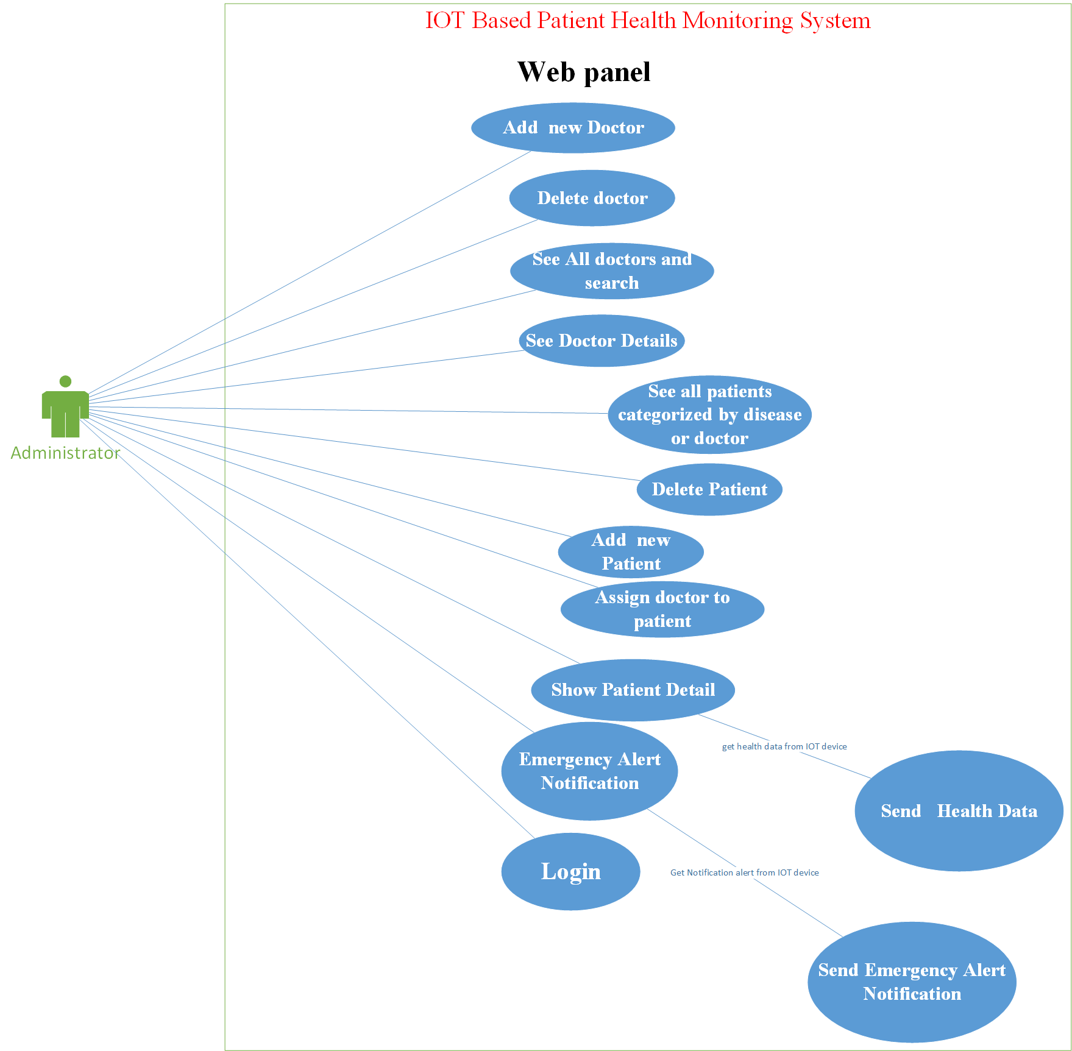

Slide 70
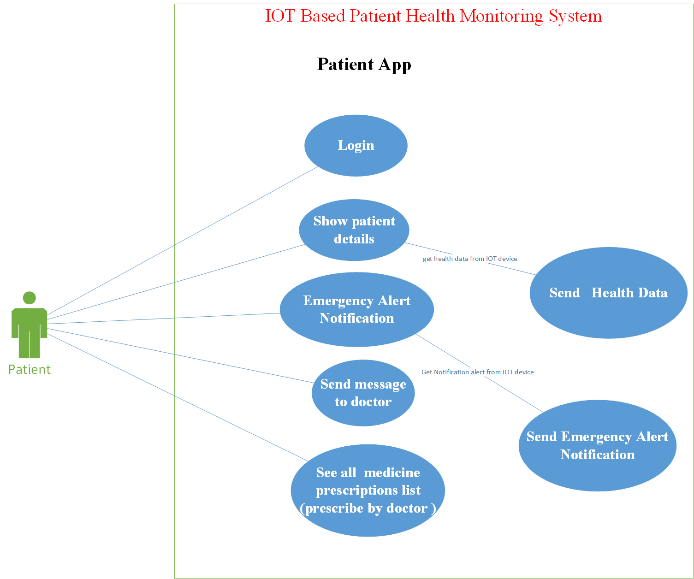

Slide 71
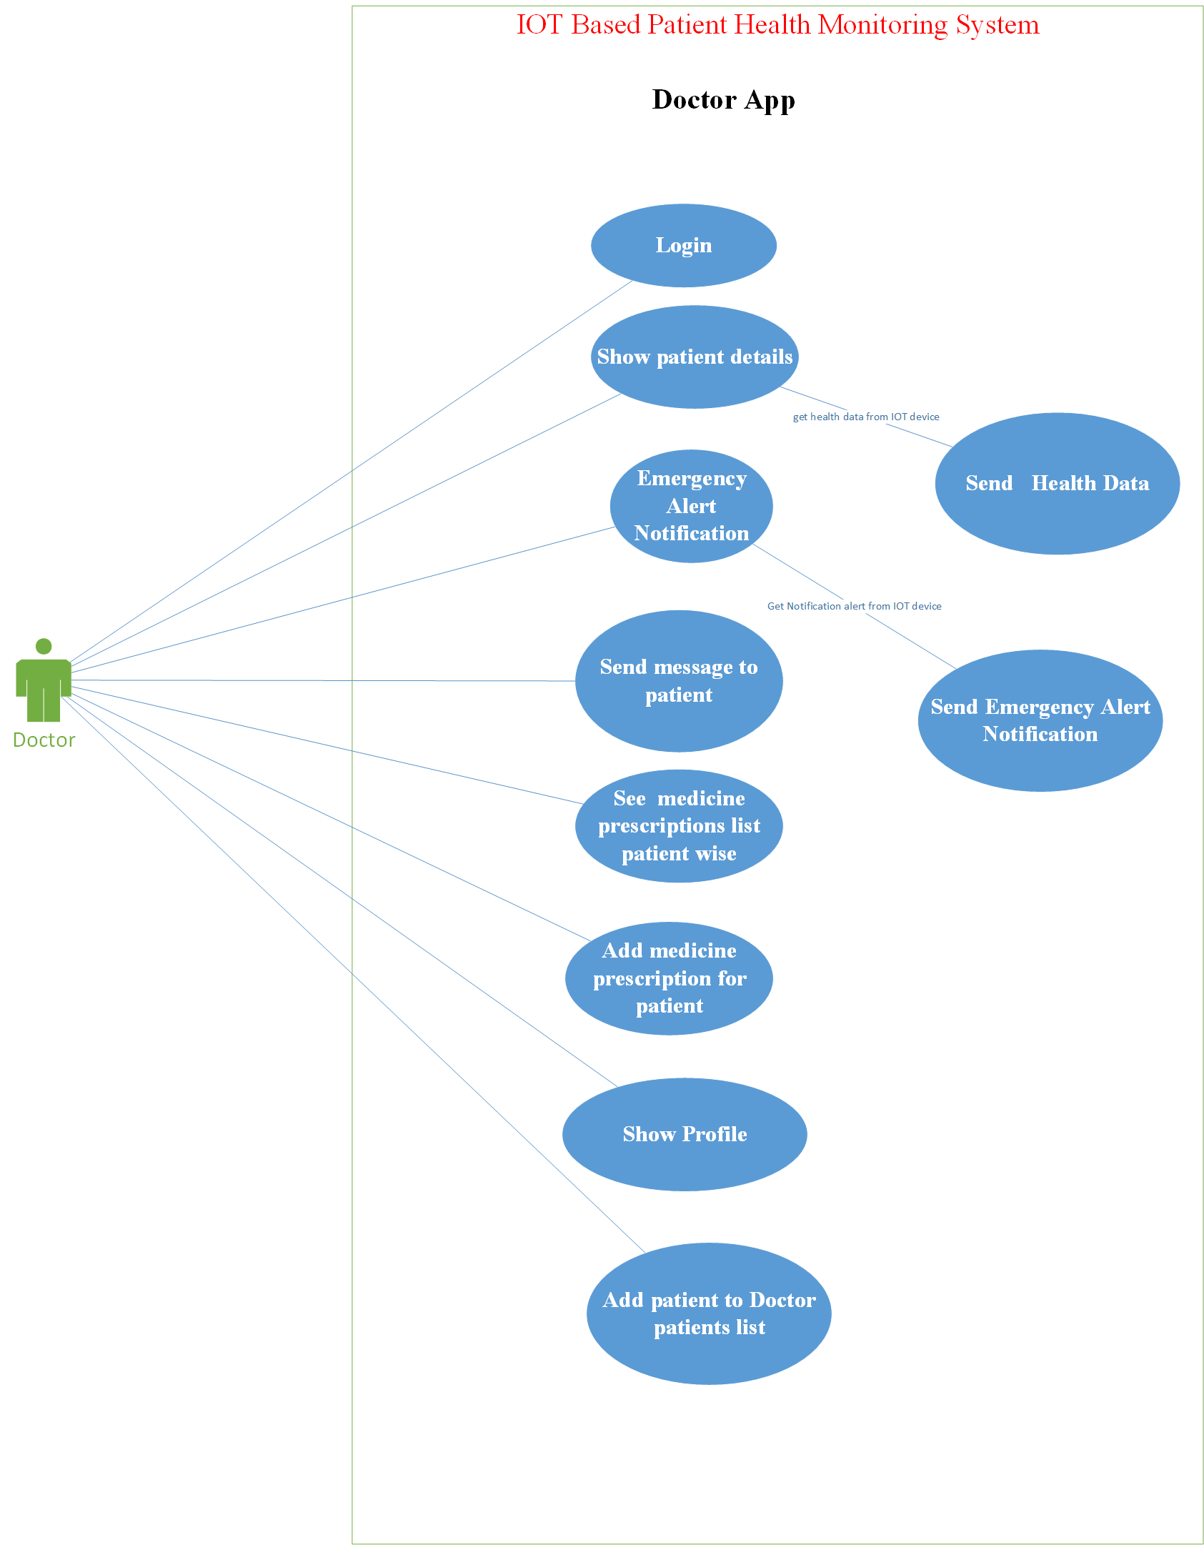

Slide 72
Design
Activity Diagram

Slide 73
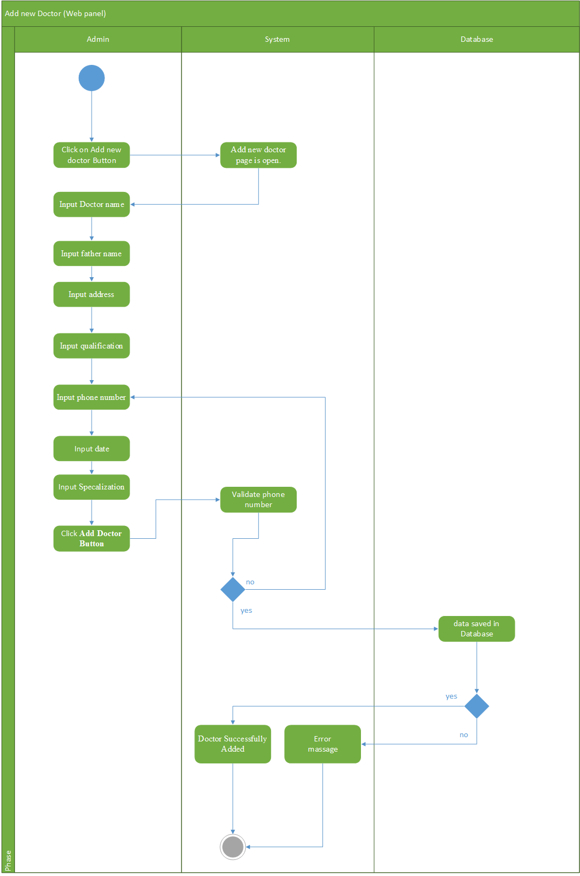

Slide 74
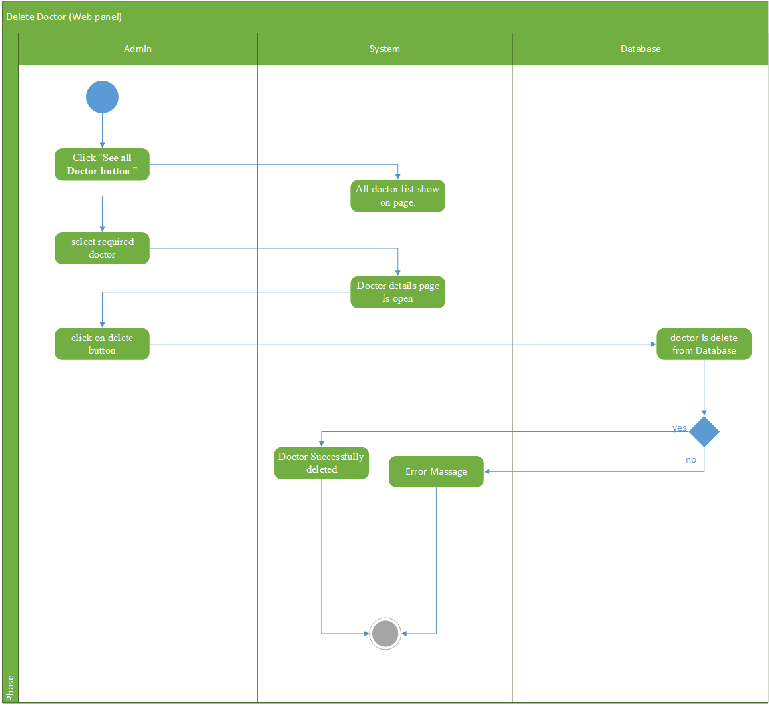

Slide 75
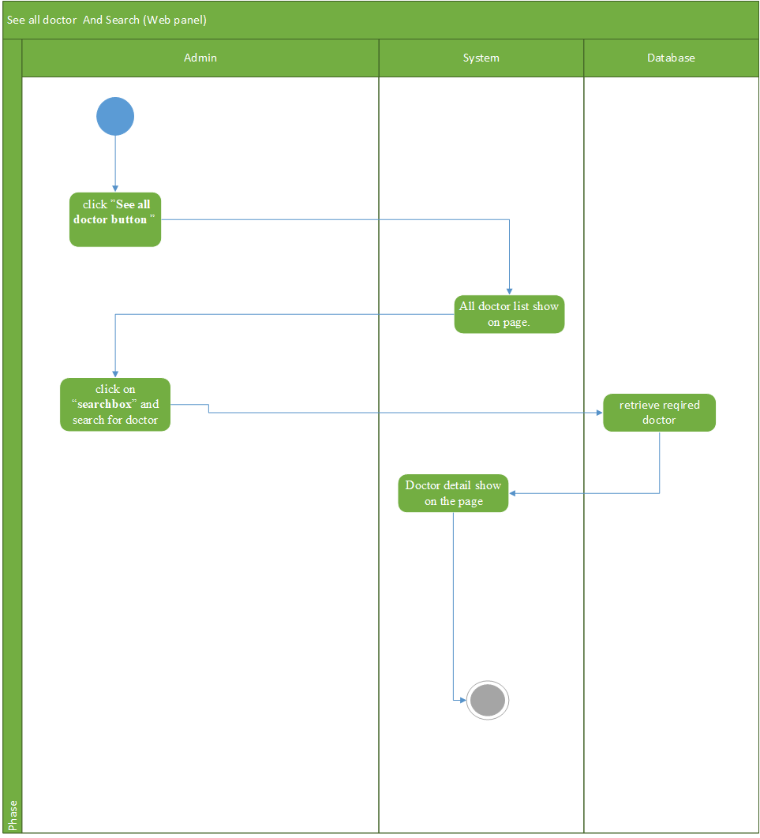

Slide 76
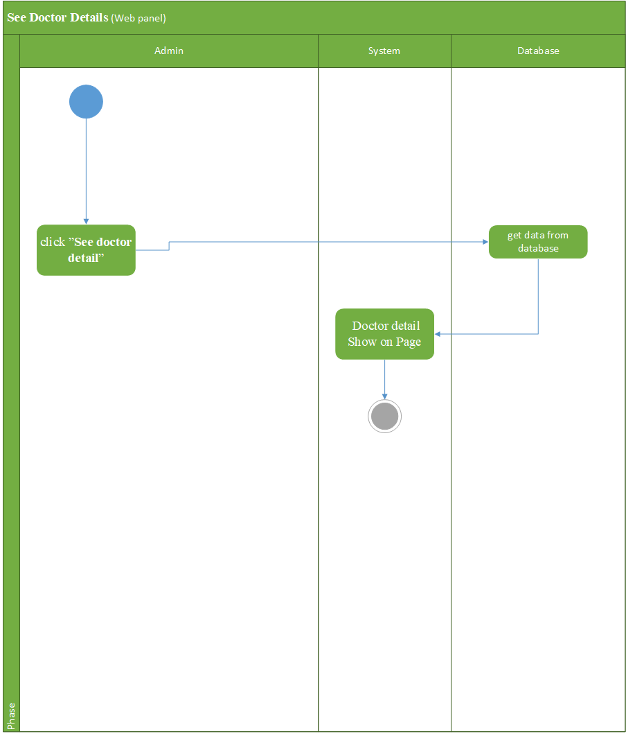

Slide 77
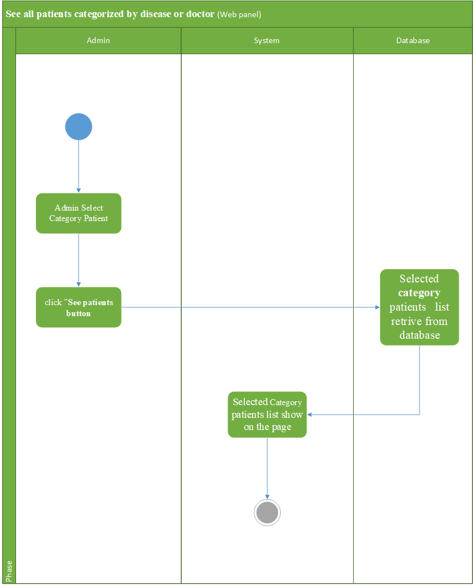

Slide 78
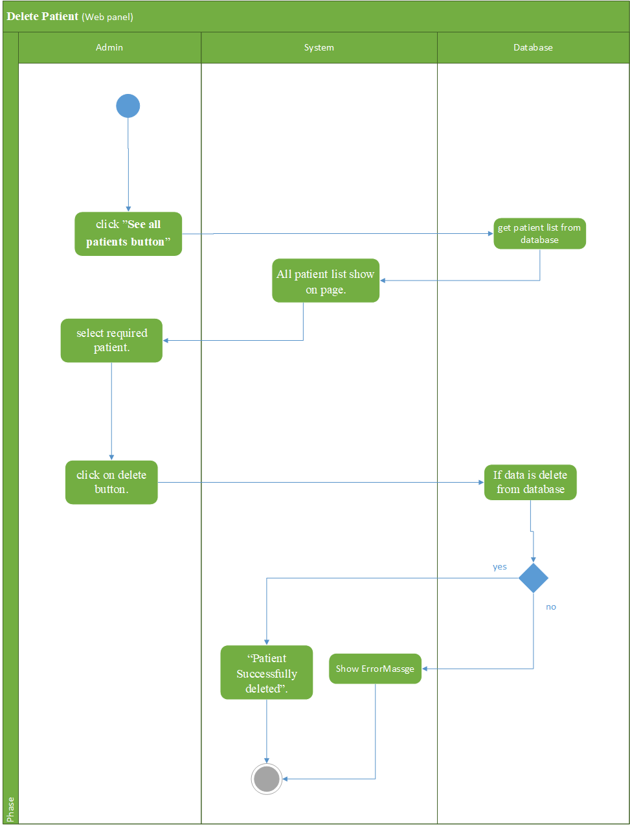

Slide 79
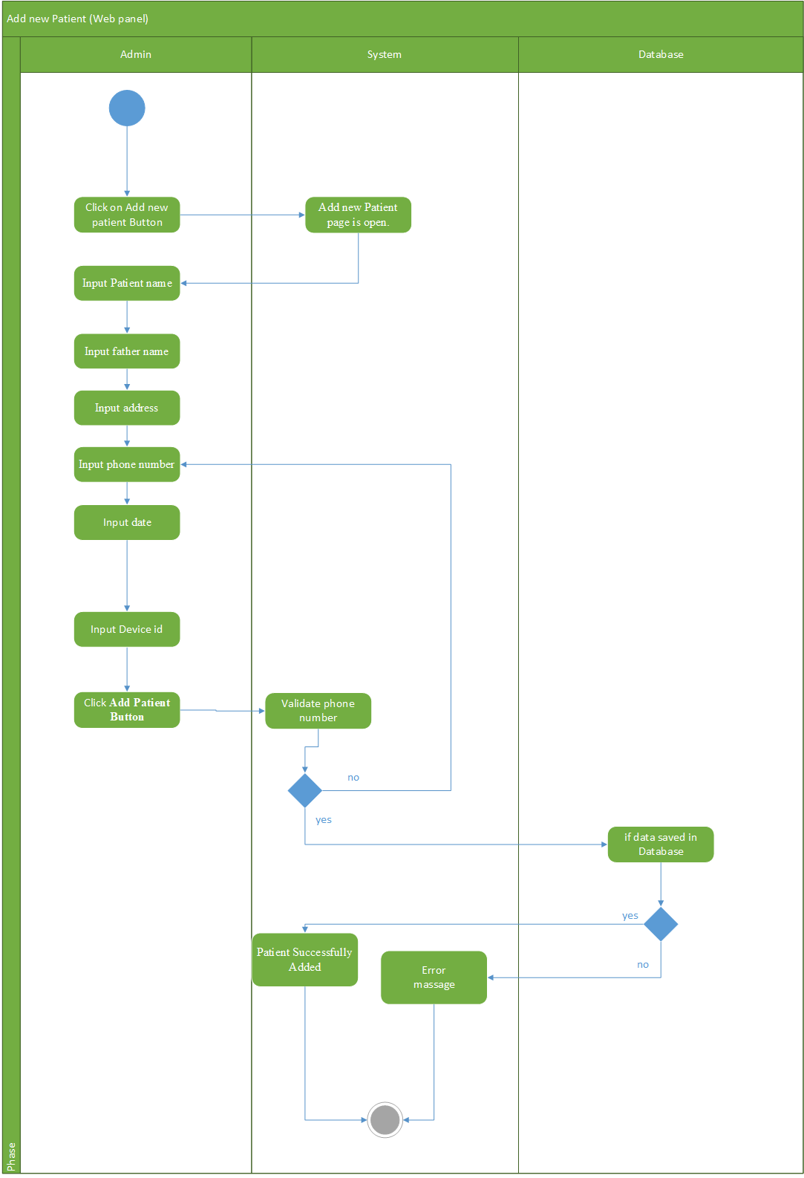

Slide 80
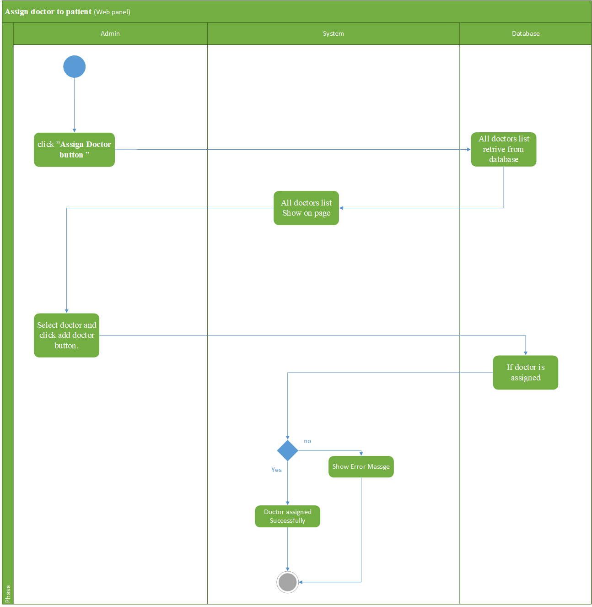

Slide 81
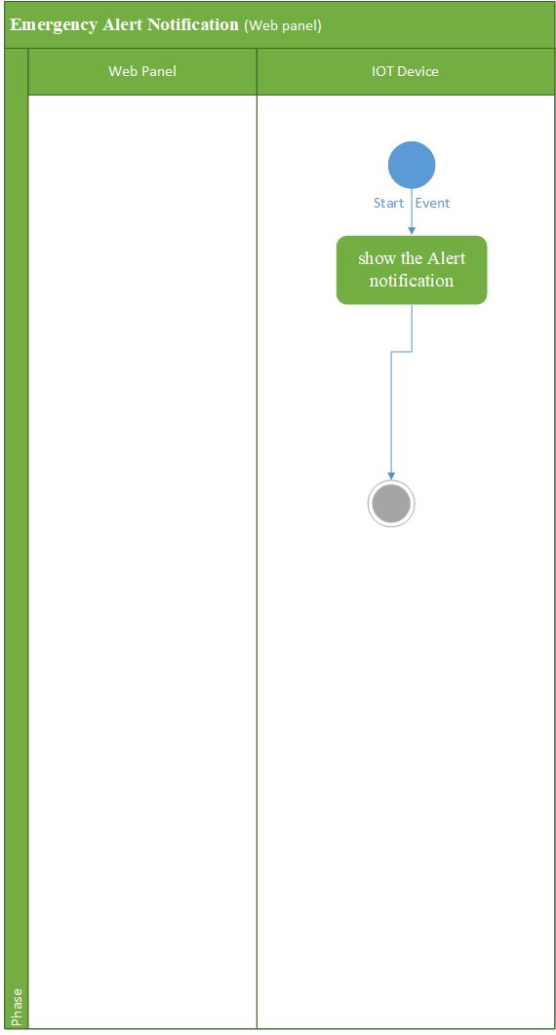

Slide 82
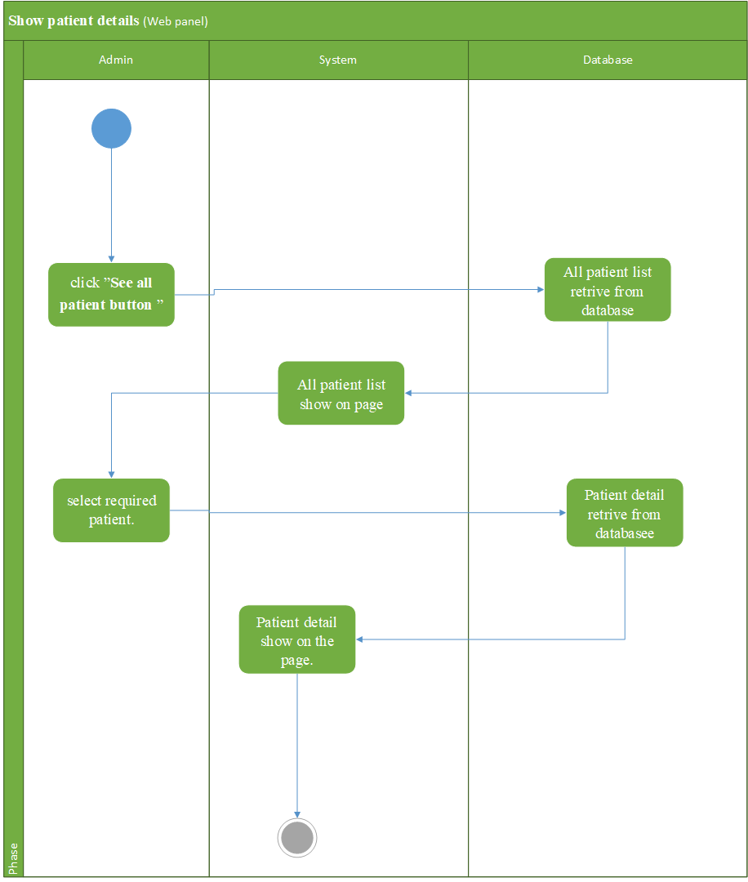

Slide 83
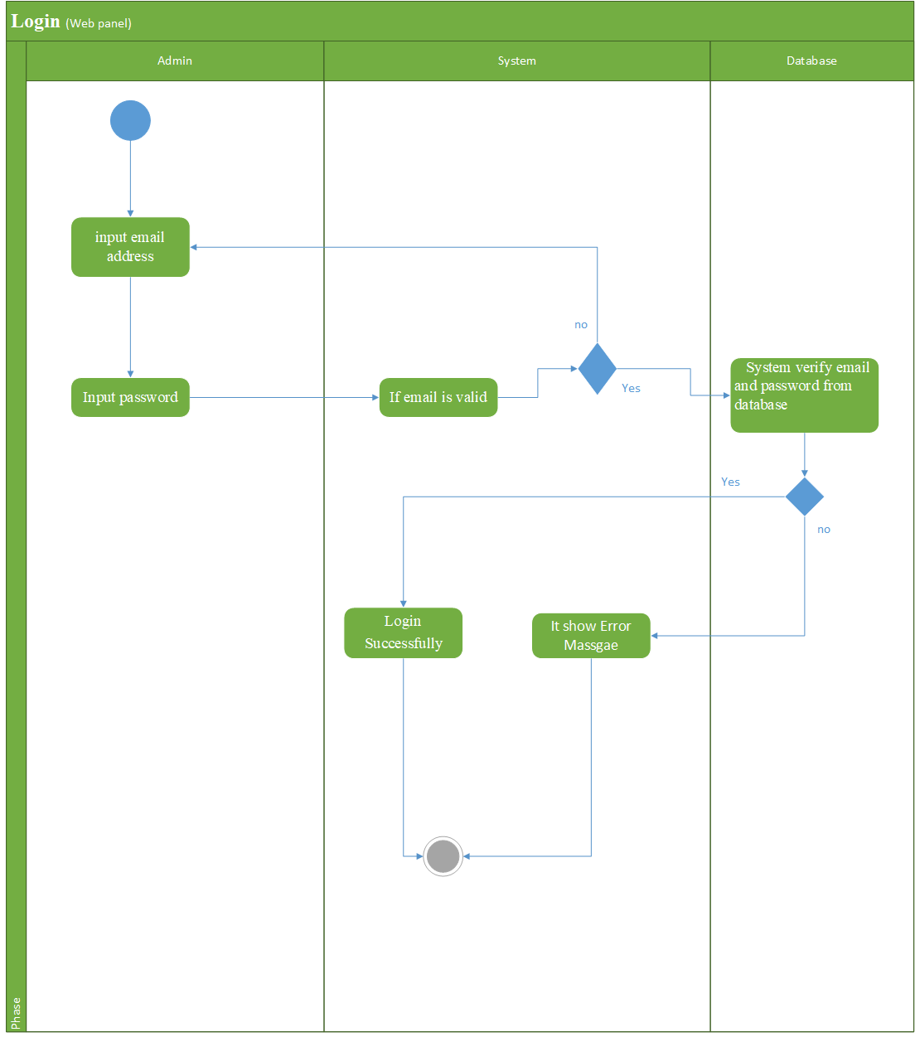

Slide 84
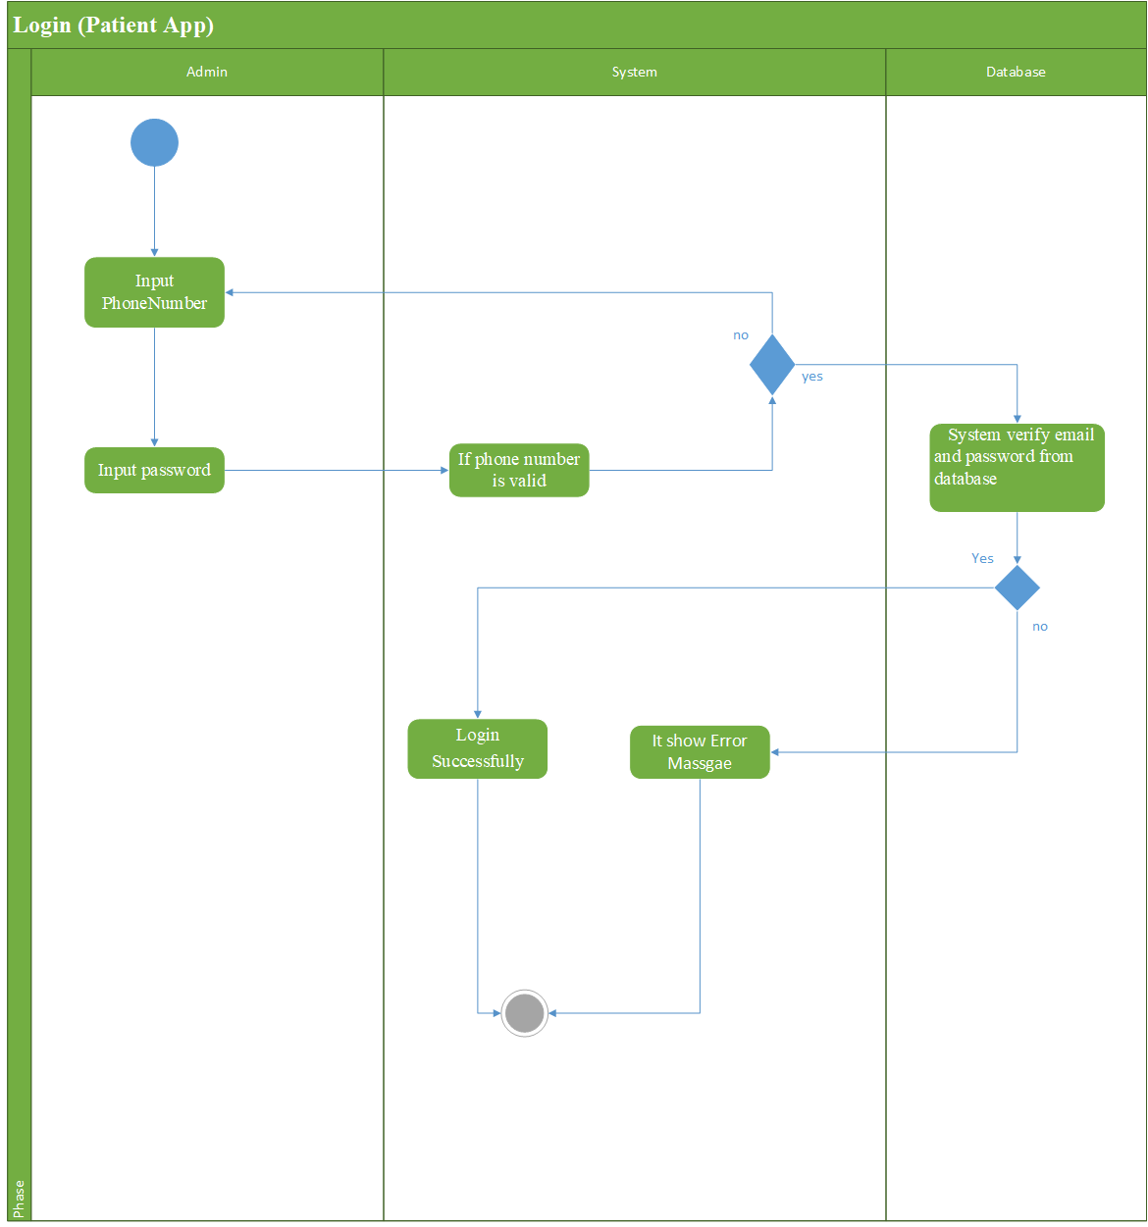

Slide 85
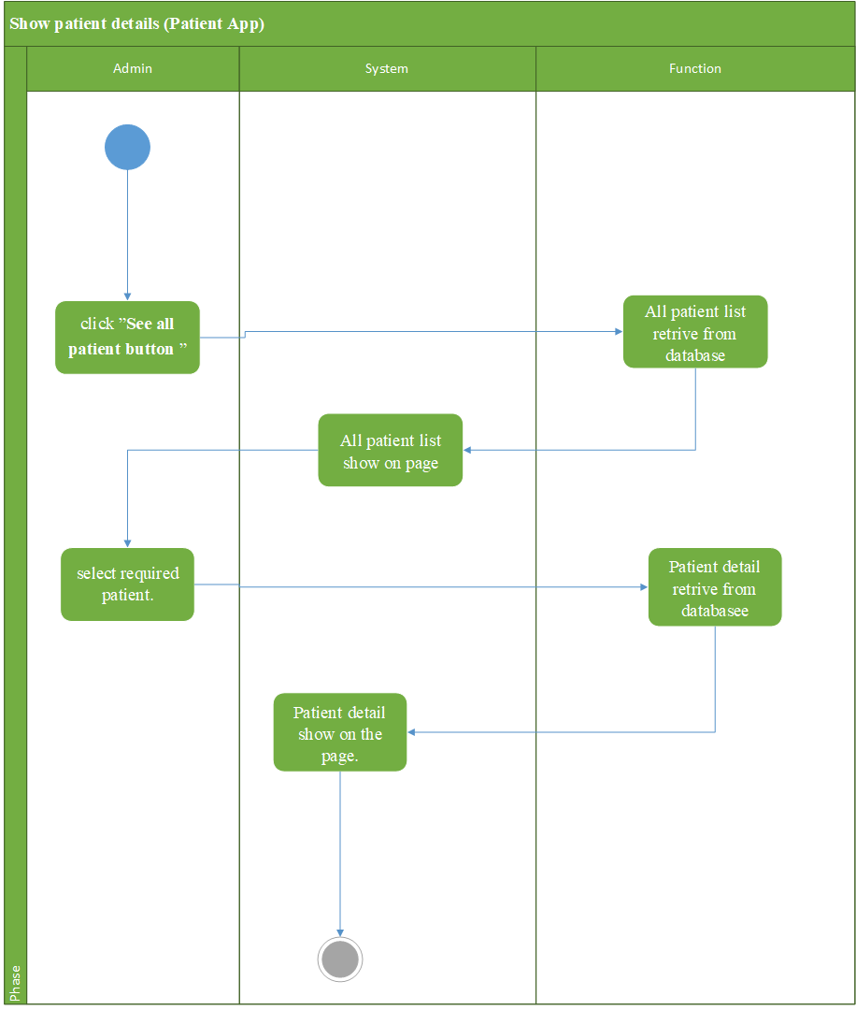

Slide 86
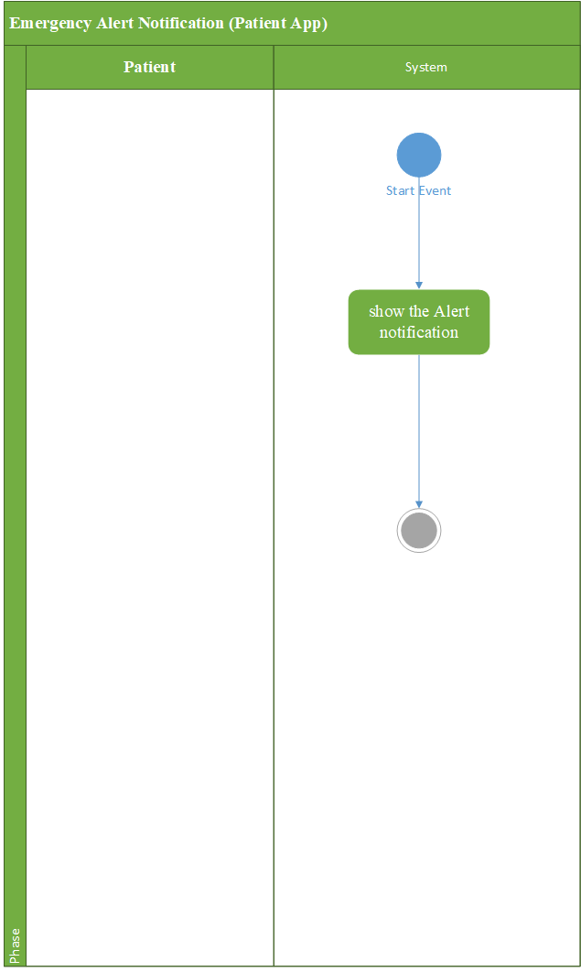

Slide 87
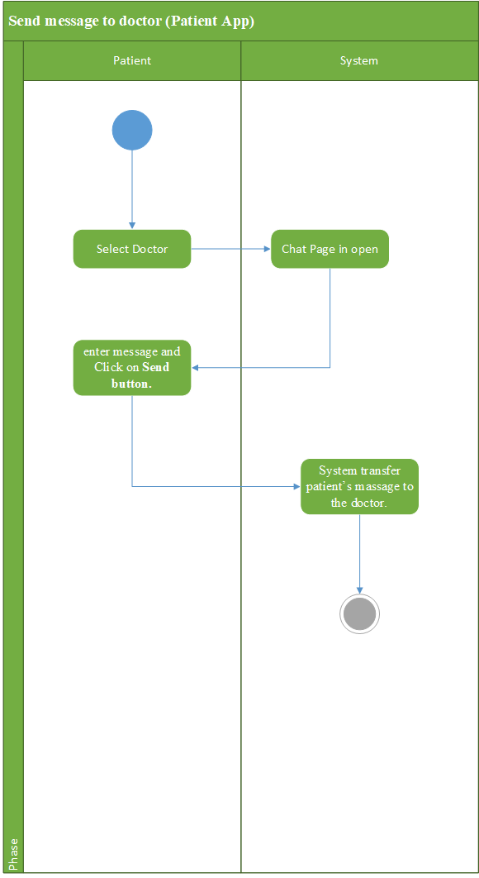

Slide 88
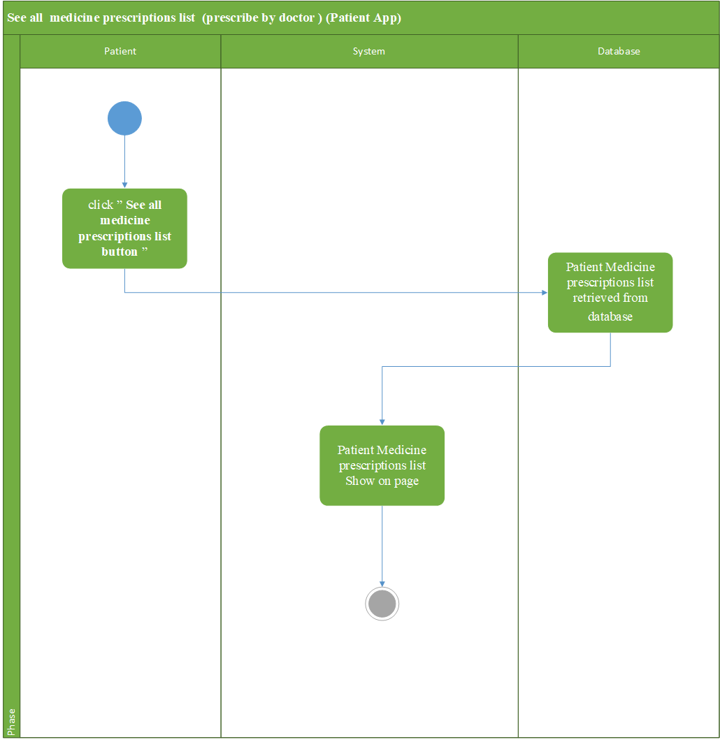

Slide 89
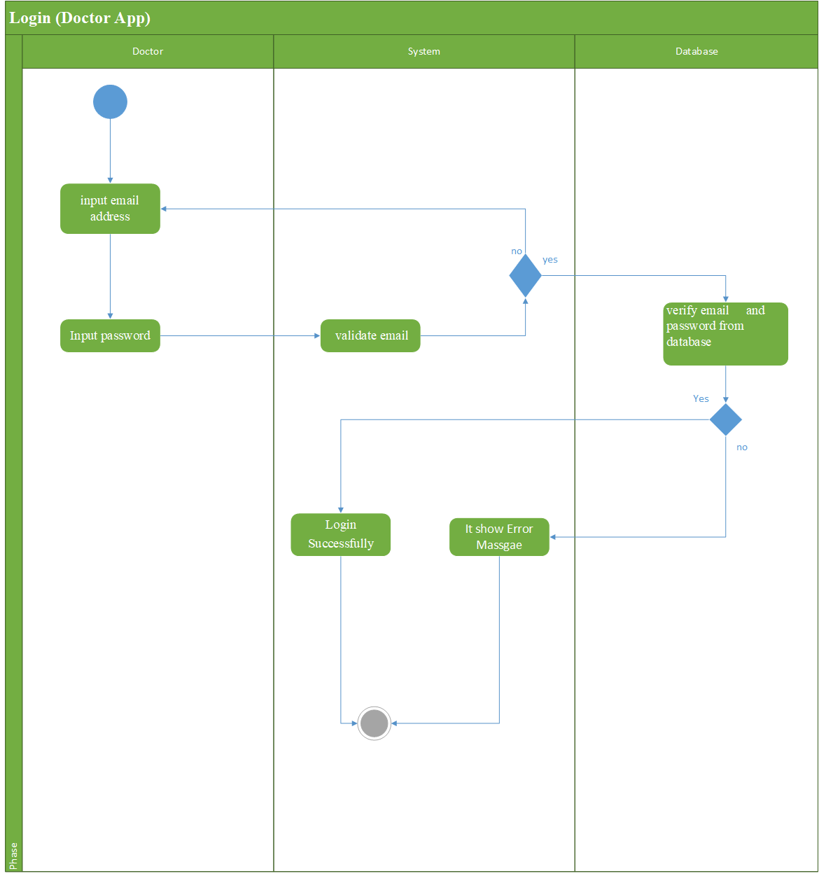

Slide 90


Slide 91
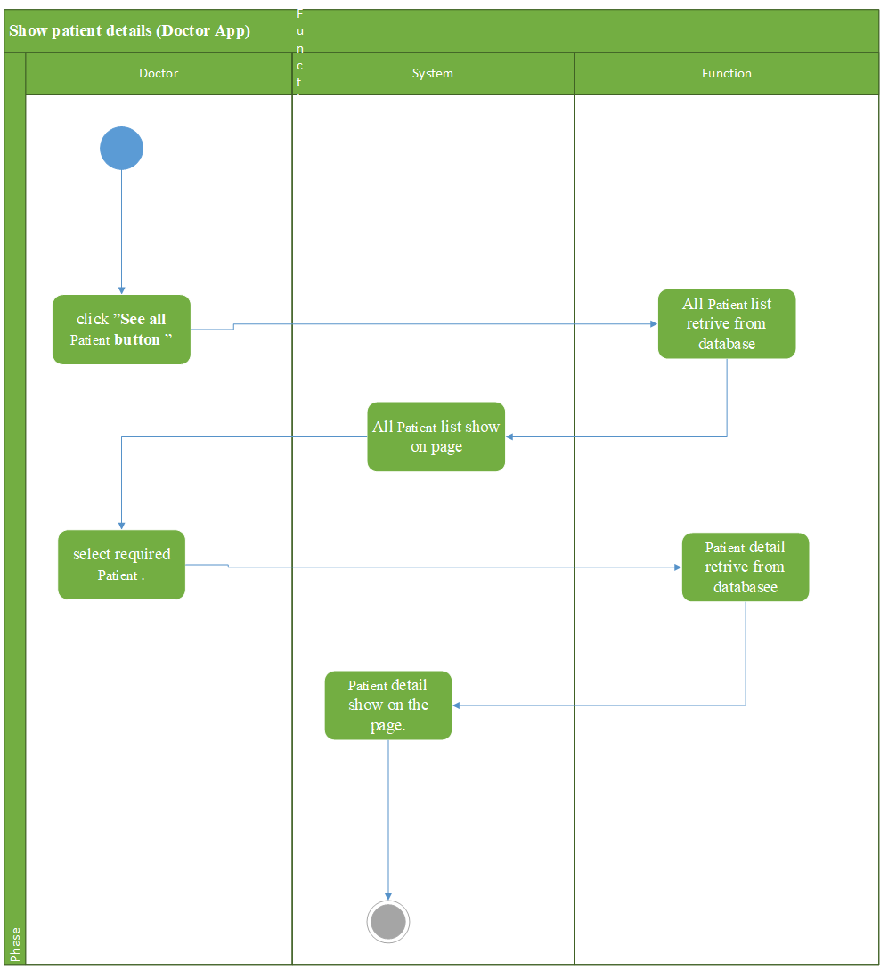

Slide 92
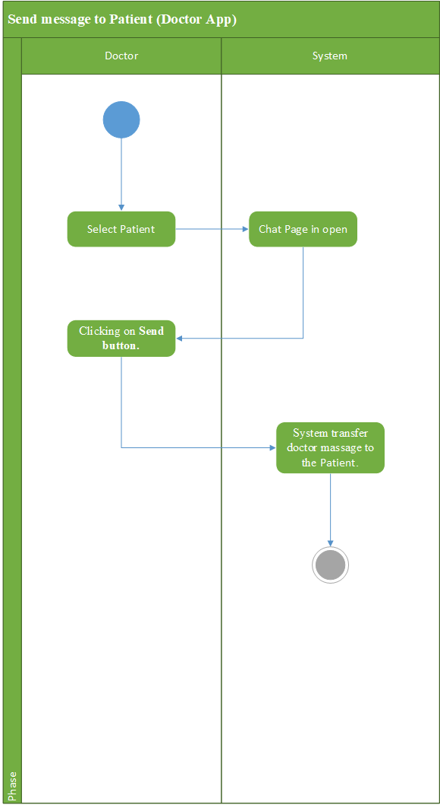

Slide 93
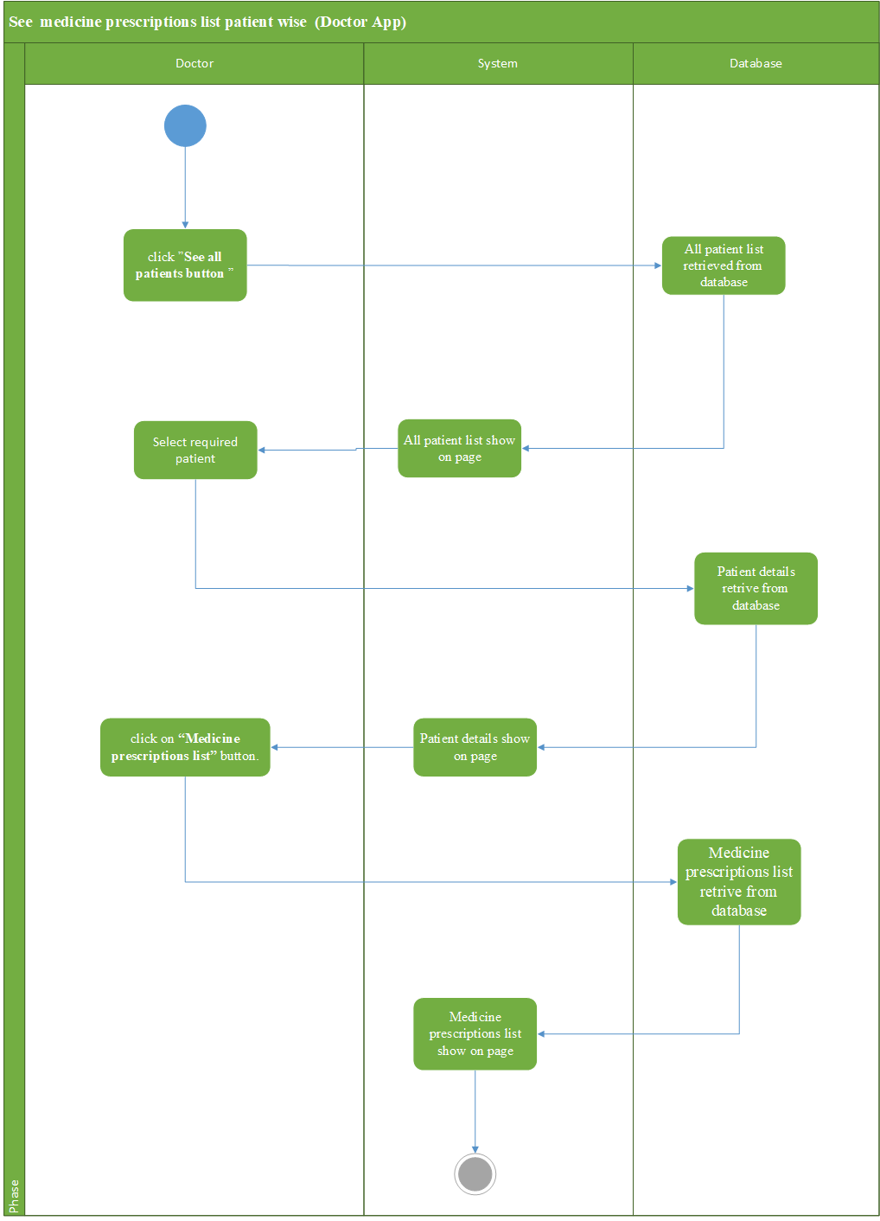

Slide 94
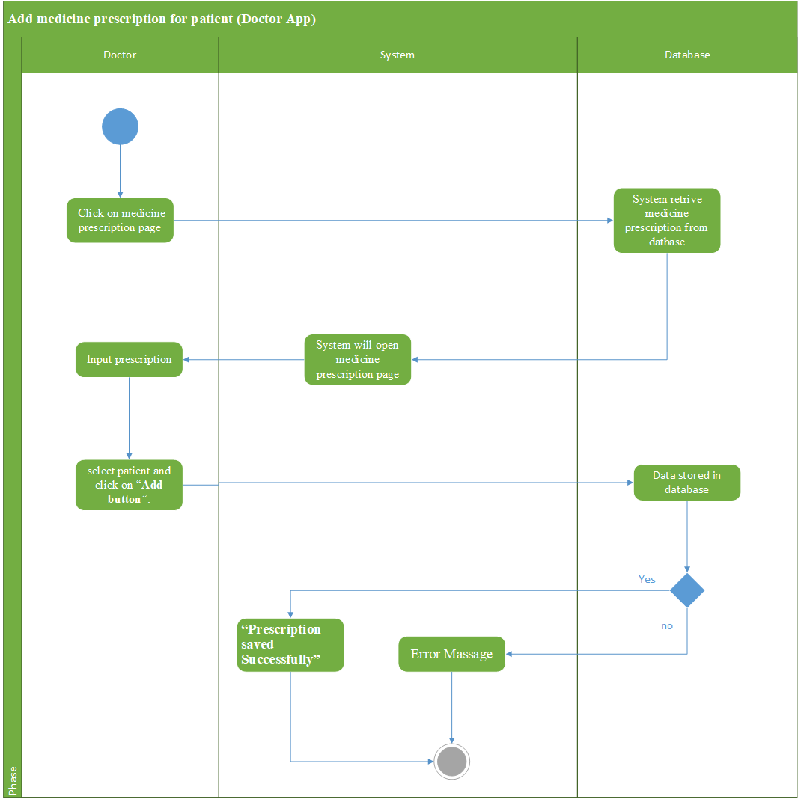

Slide 95
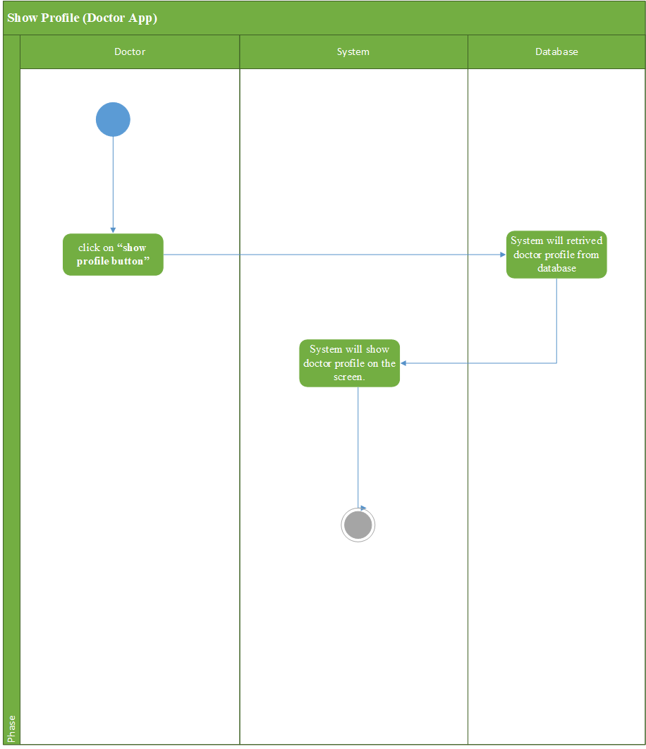

Slide 96
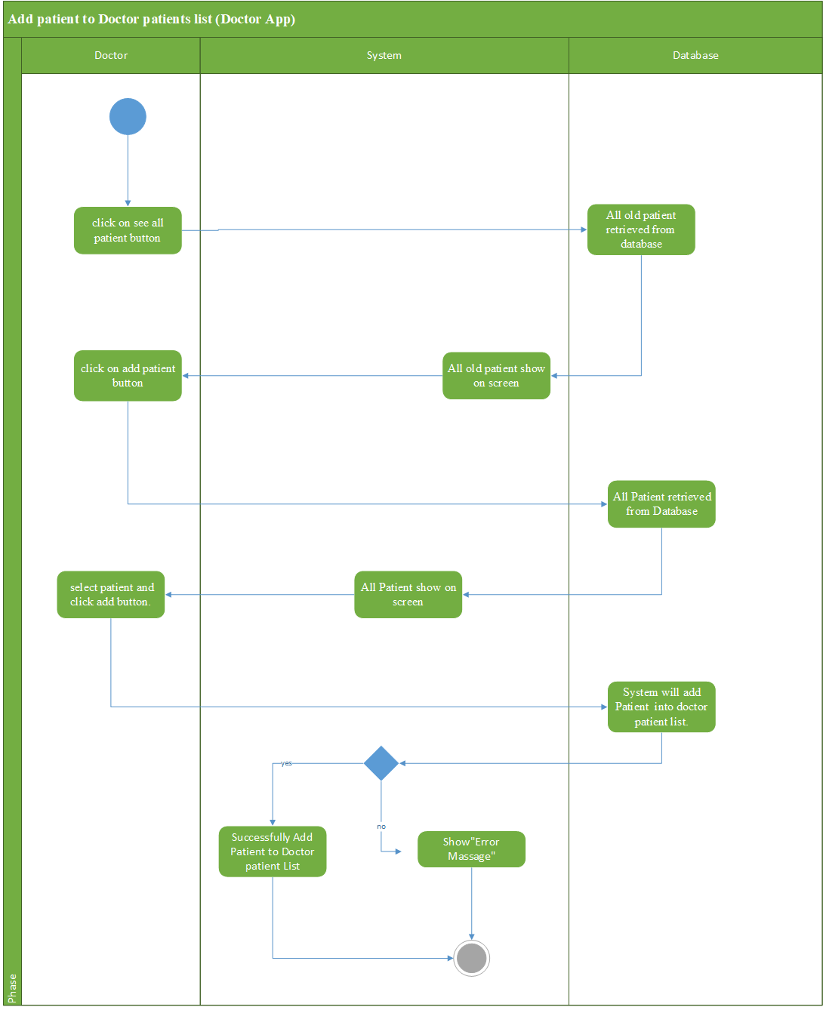

Slide 97
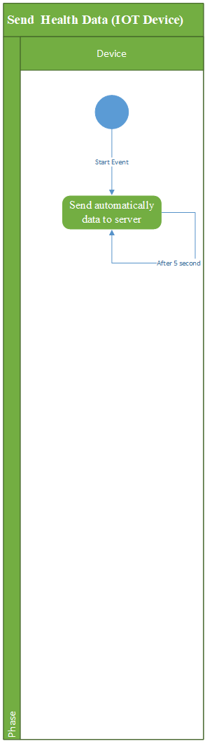

Slide 98
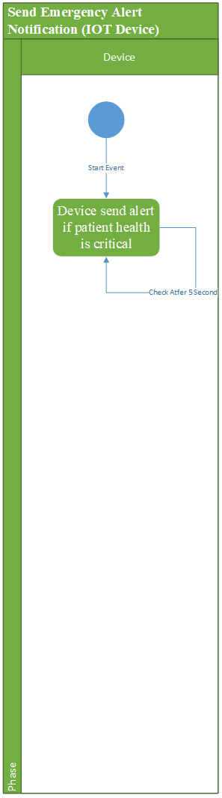

Slide 99


Slide 100


Slide 101
Design
Sequence Diagram

Slide 102
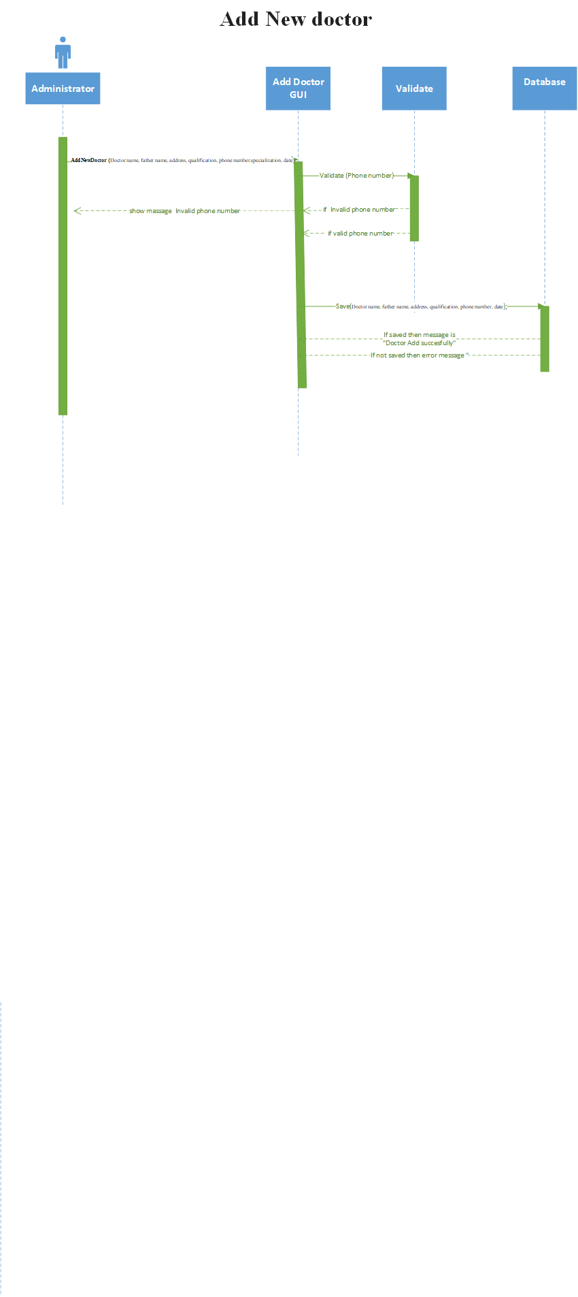

Slide 103
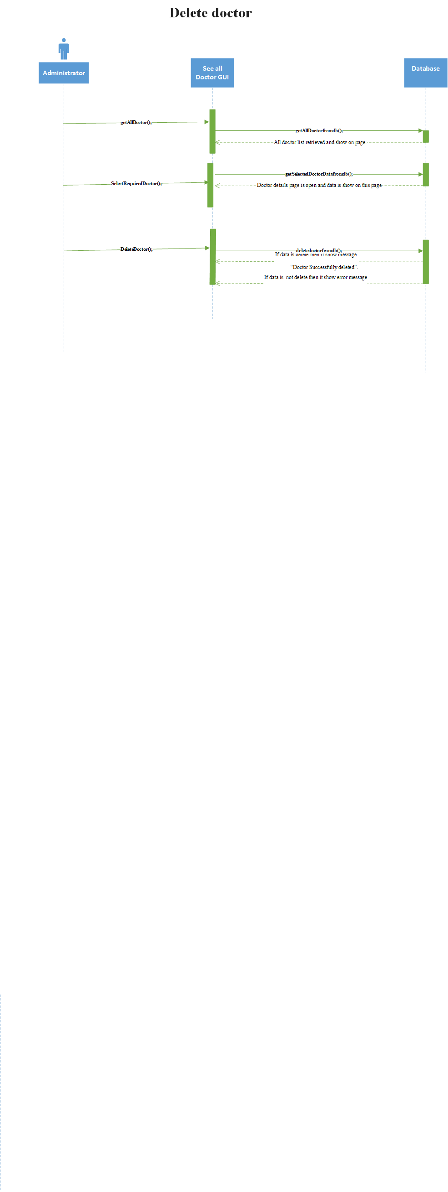

Slide 104
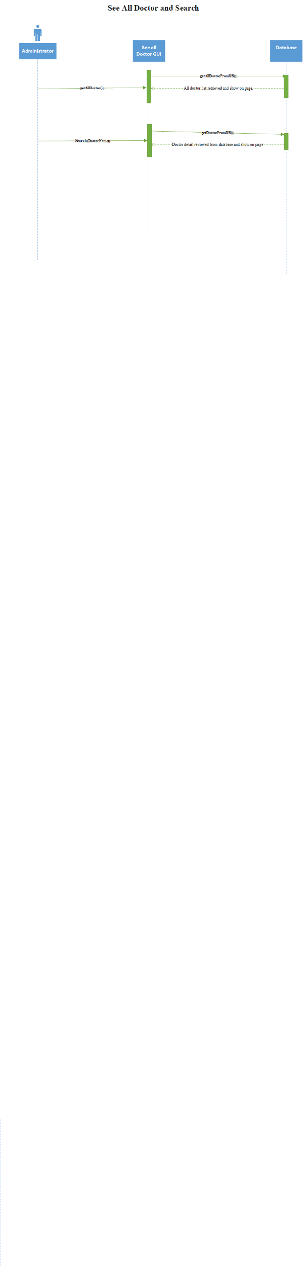

Slide 105
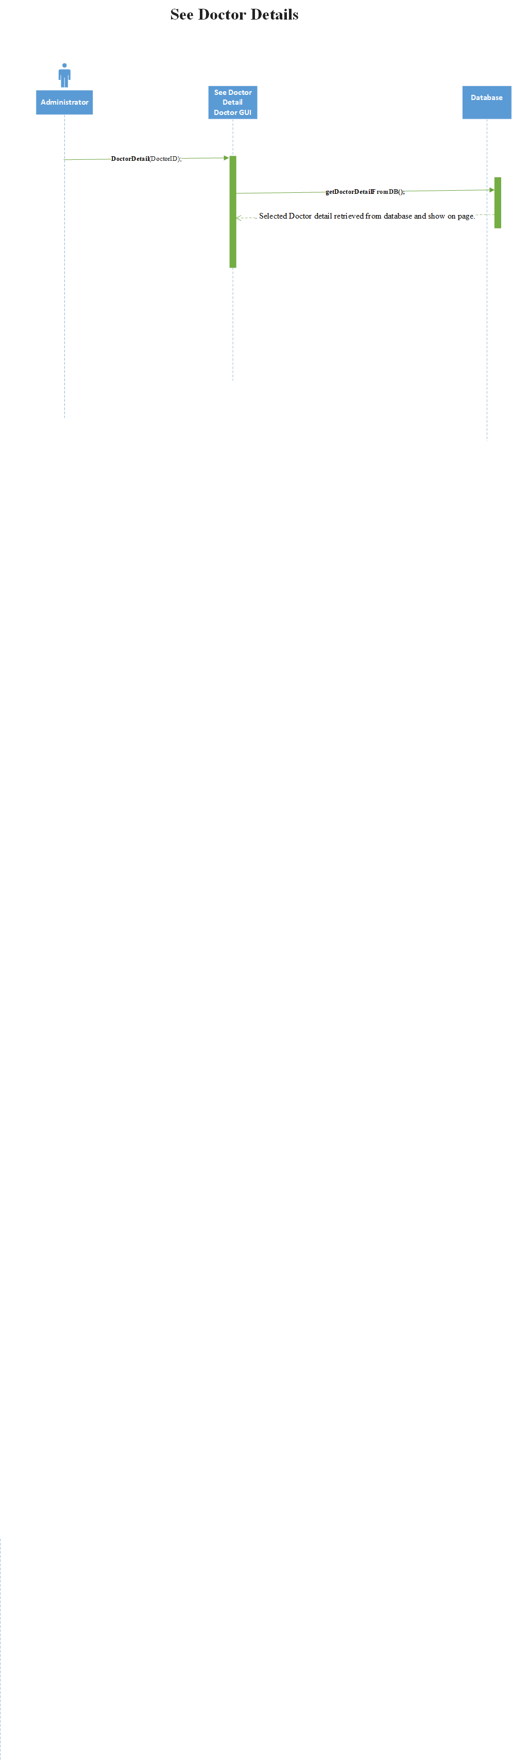

Slide 106
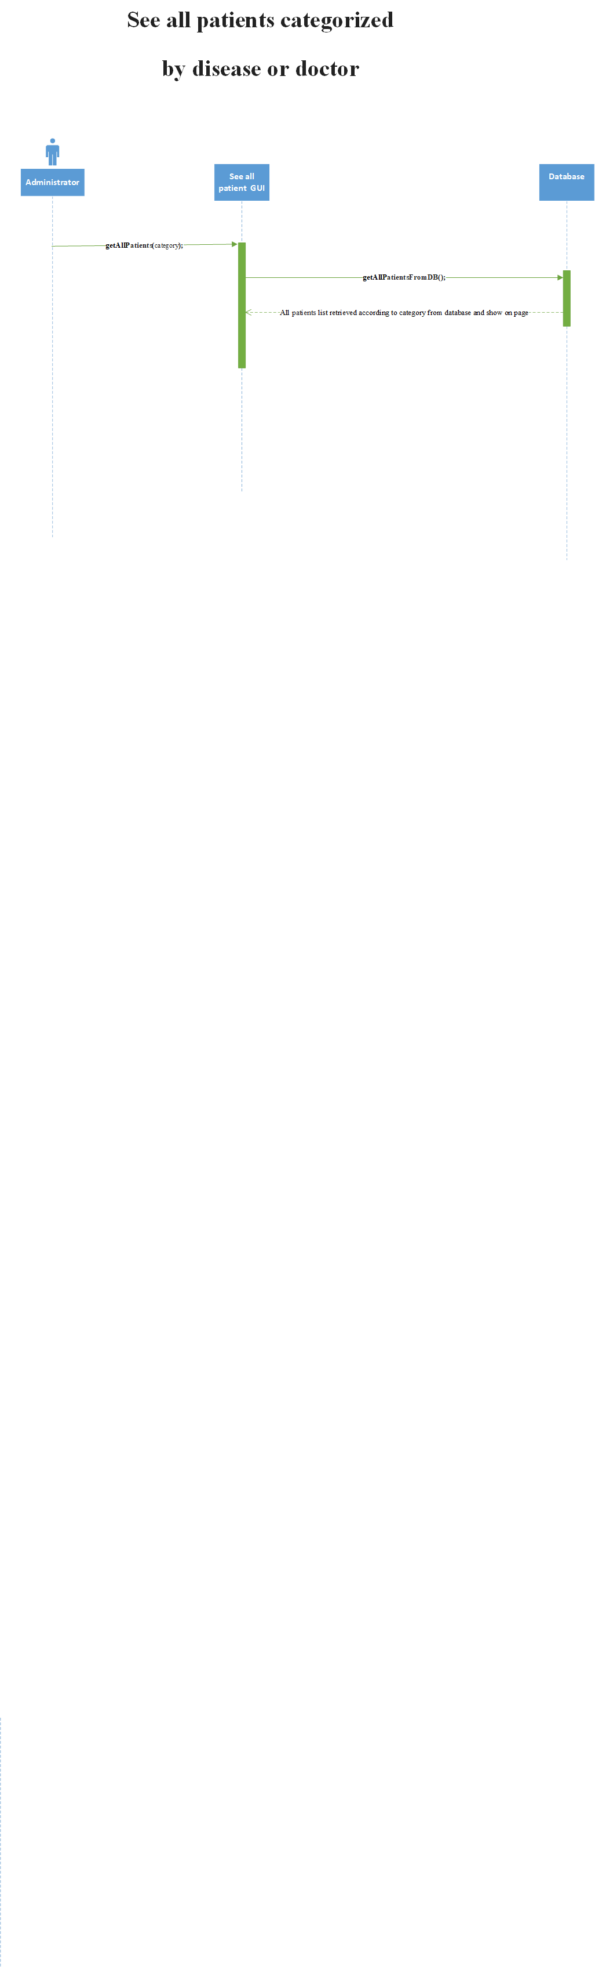

Slide 107
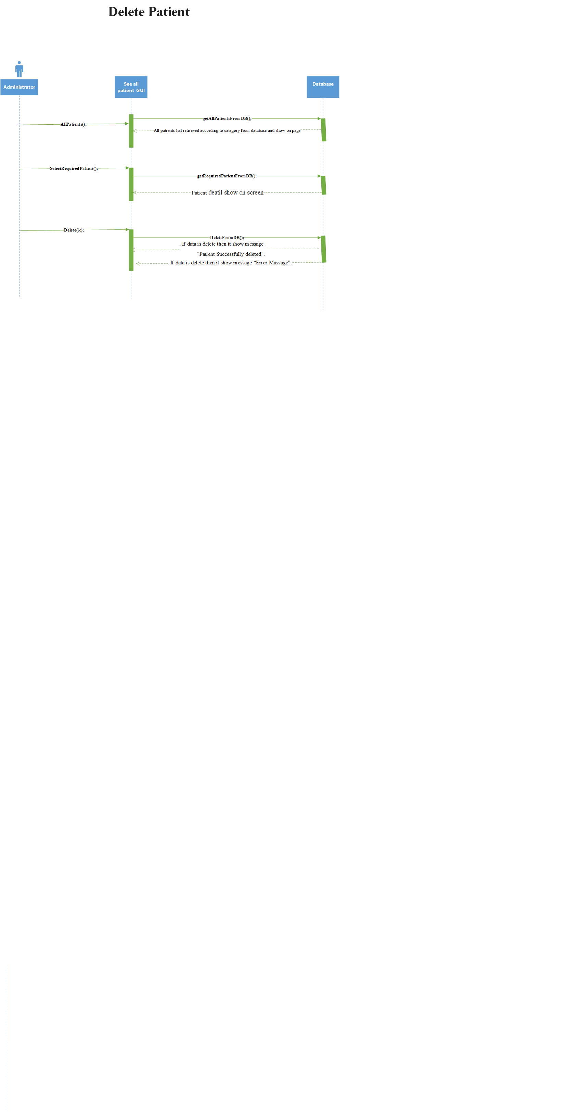

Slide 108
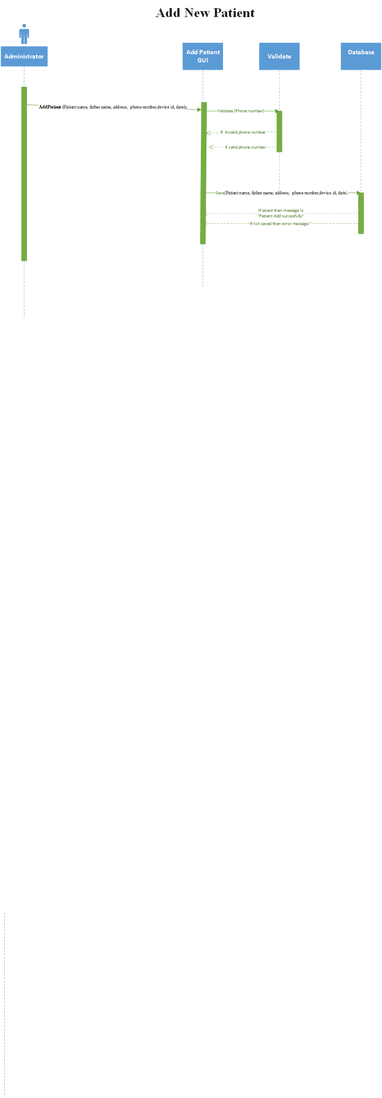

Slide 109
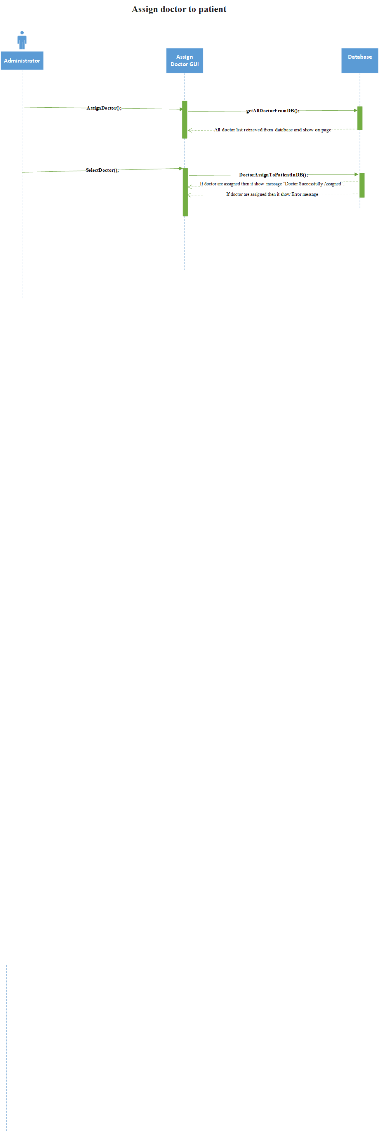

Slide 110
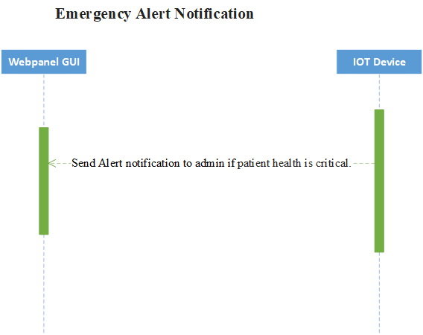

Slide 111
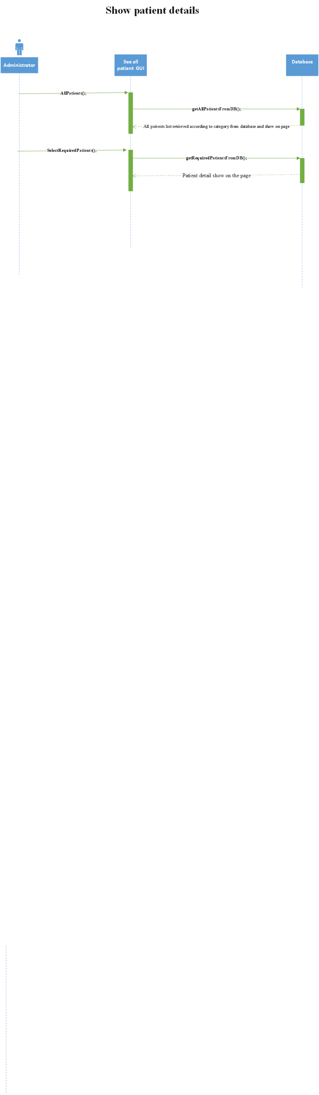

Slide 112
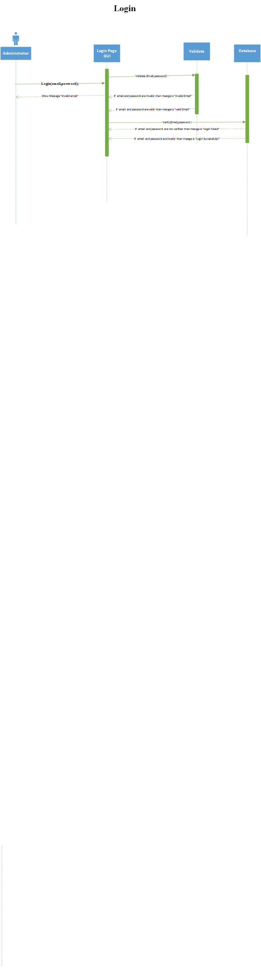

Slide 113
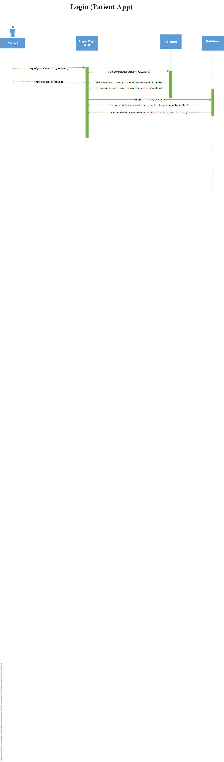

Slide 114
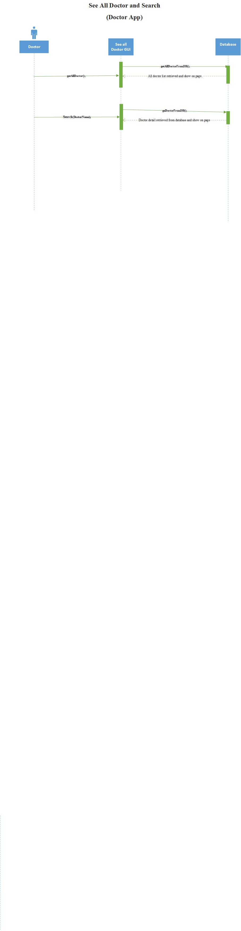

Slide 115
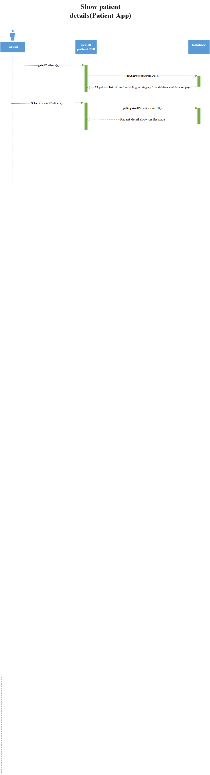

Slide 116
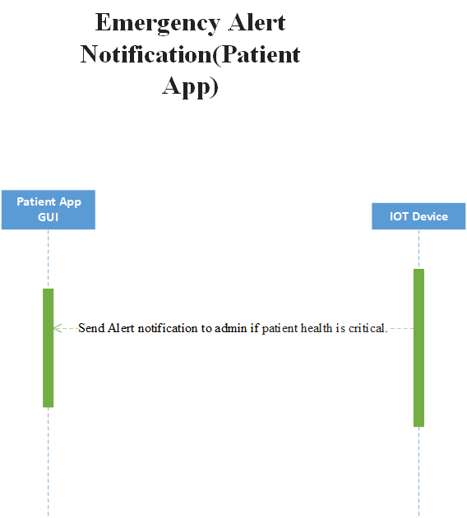

Slide 117
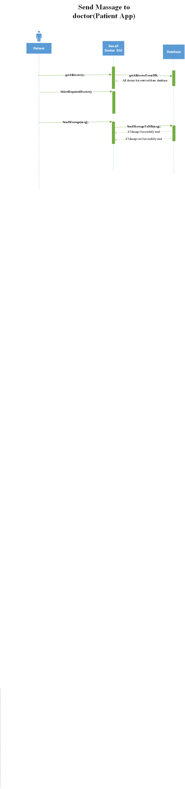

Slide 118
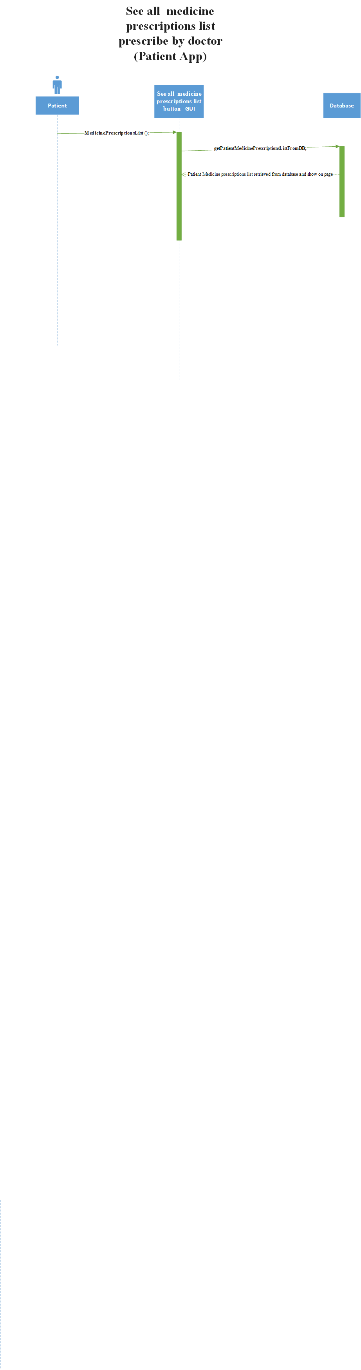

Slide 119
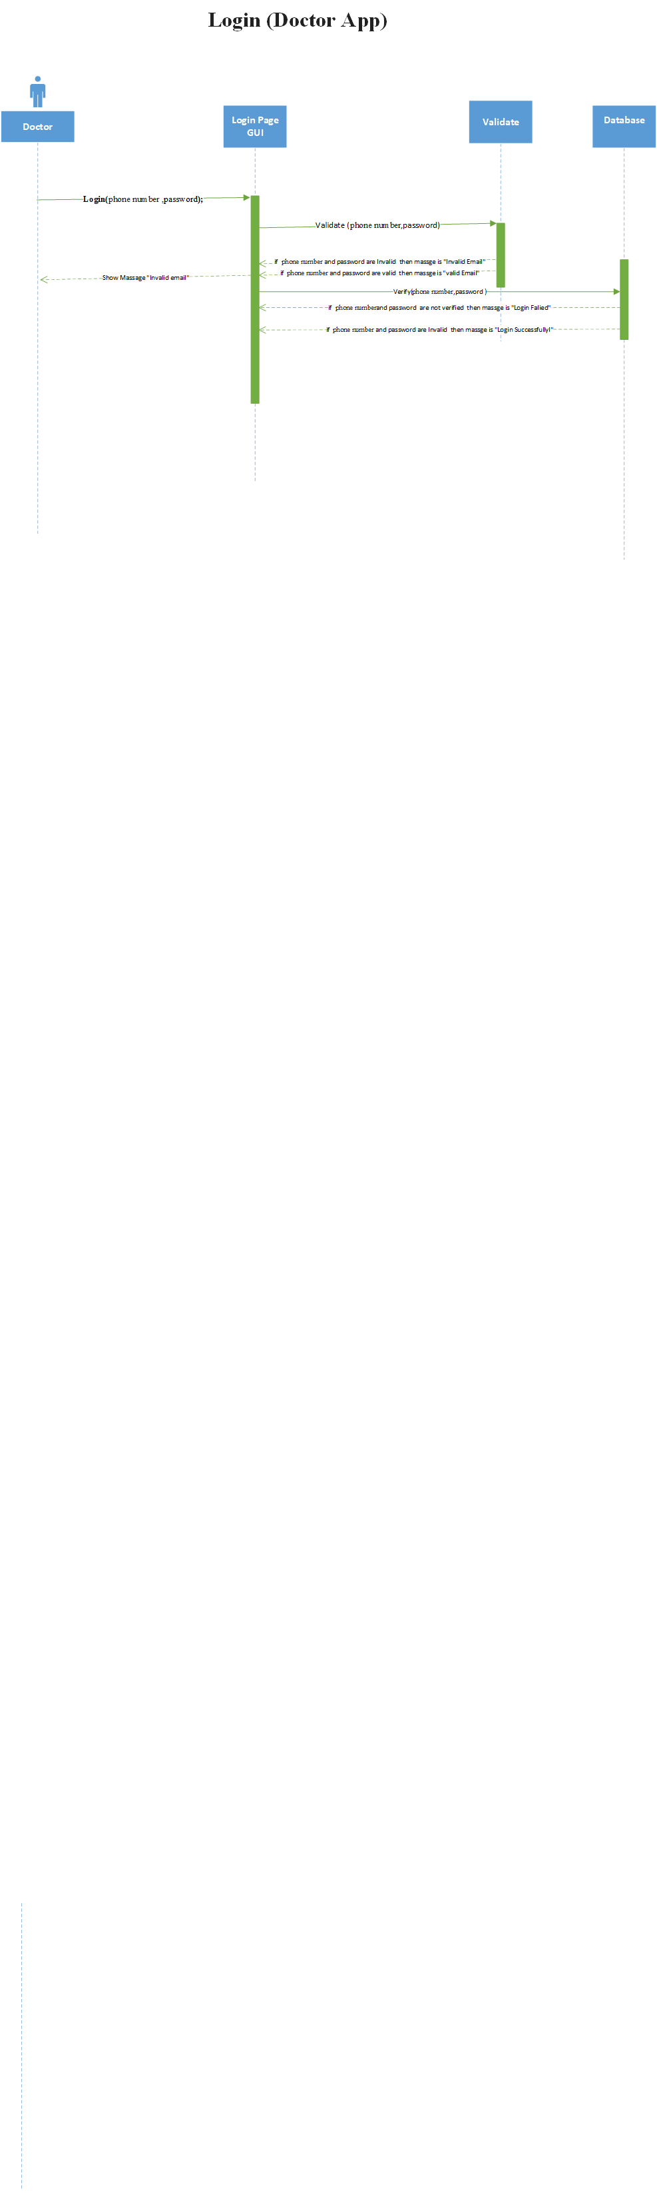

Slide 120
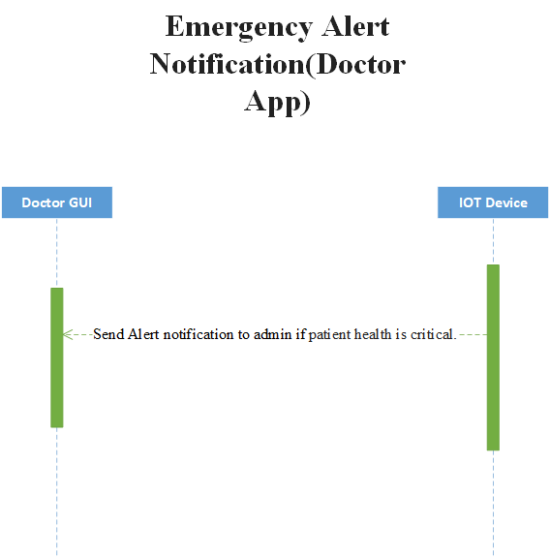

Slide 121
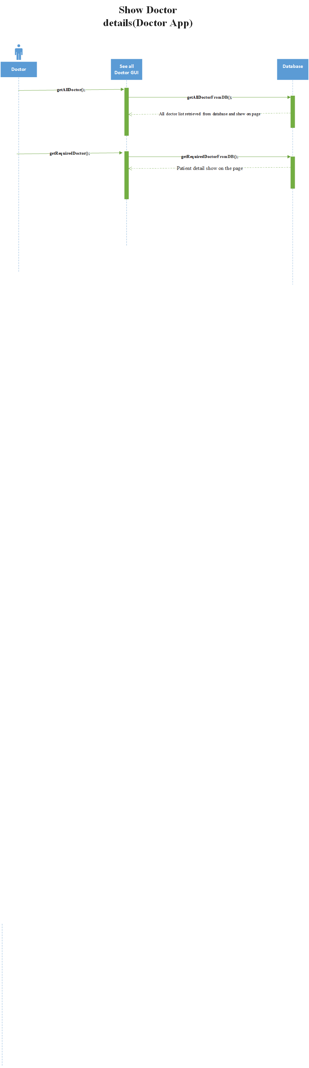

Slide 122
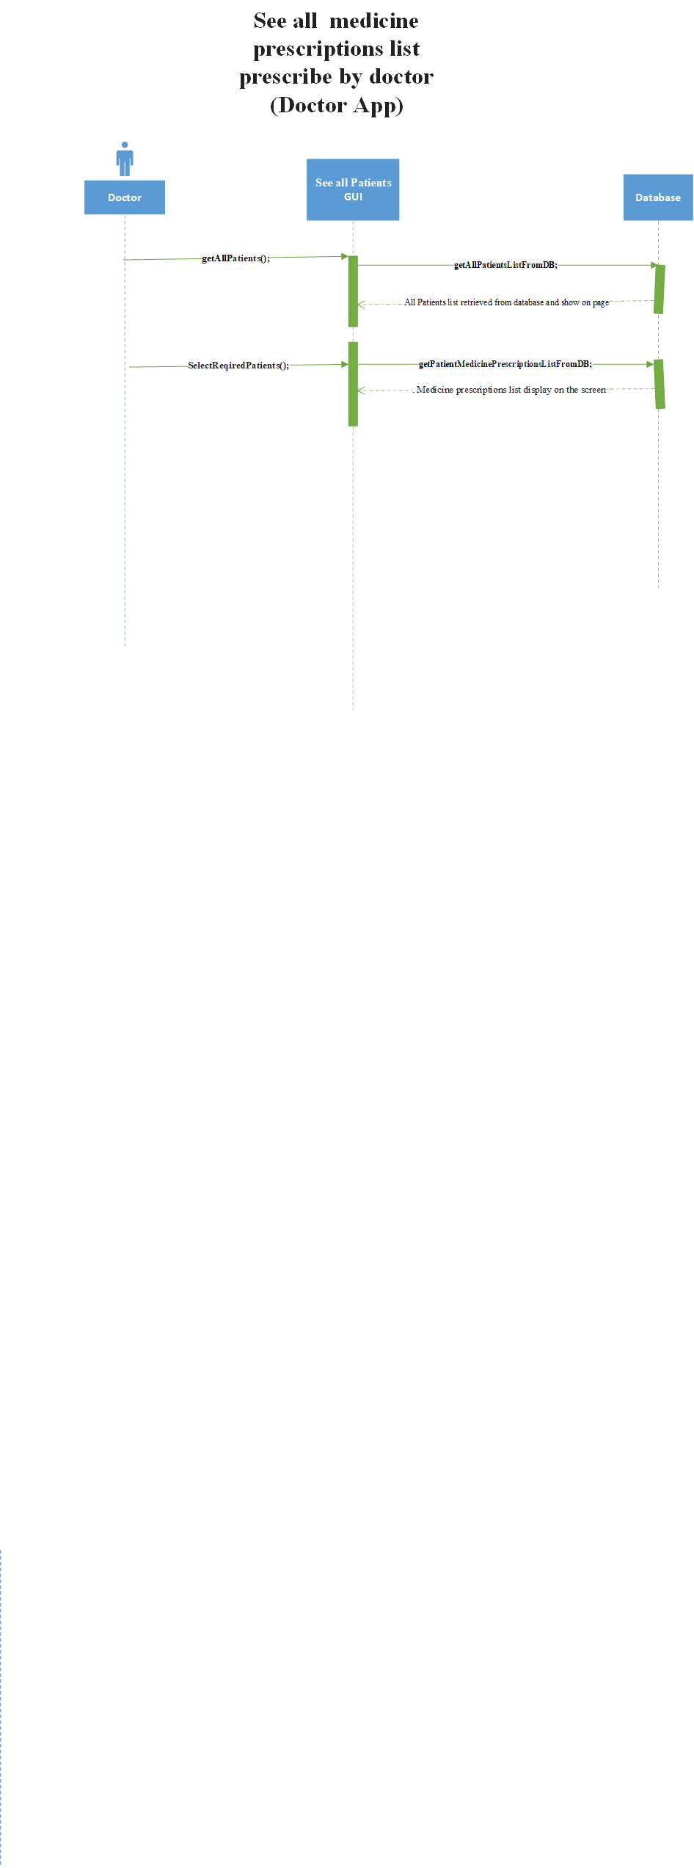

Slide 123
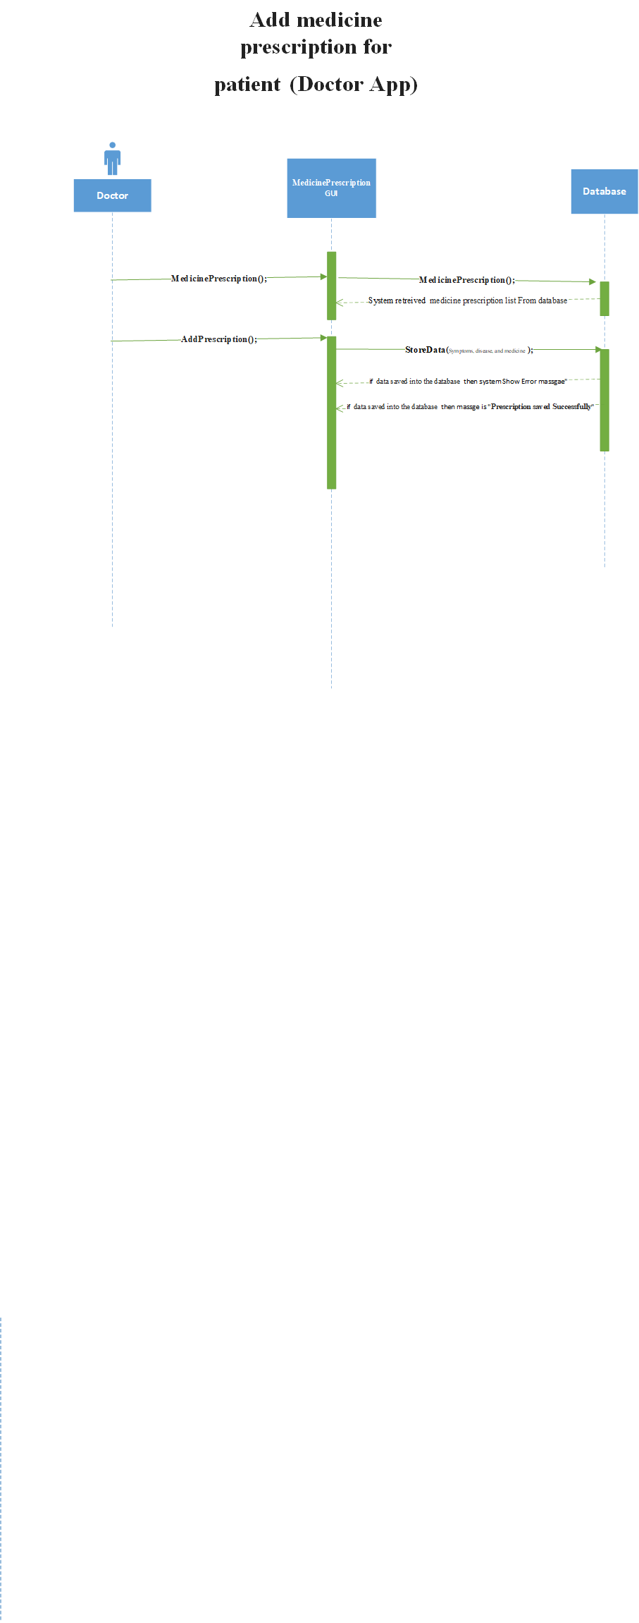

Slide 124


Slide 125


Slide 126


Slide 127


Slide 128


Slide 129


Slide 130
Design
Collaboration Diagram

Slide 131


Slide 132


Slide 133


Slide 134


Slide 135


Slide 136


Slide 137


Slide 138


Slide 139


Slide 140


Slide 141


Slide 142


Slide 143


Slide 144


Slide 145


Slide 146


Slide 147


Slide 148


Slide 149


Slide 150


Slide 151


Slide 152


Slide 153


Slide 154


Slide 155


Slide 156


Slide 157


Slide 158


Slide 159
Design
Class Diagram

Slide 160


Slide 161
Design
Data Flow Diagram

Slide 162


Slide 163


Slide 164
Design
ERD

Slide 165


Slide 166
Design
State Machine

Slide 167


Slide 168


Slide 169


Slide 170
Design
Component and Deployment Diagram

Slide 171


Slide 172
Project management
Millstone

Slide 173


Slide 174
Project management
Project Plan(Gantt Chart)

Slide 175


Slide 176
Project management
Resources Management

Slide 177
Project management
Risk Management

Slide 178
Risk Management
Risk management is about maximizing your chances of project success by identifying risks early on and planning how to manage them.
Some risk are described as:-
Activities are missing from scope Required activities are missing from scope definition.
Design is infeasible The design isn't possible, is excessively costly or doesn't support the requirements.
Delays to required infrastructure Delays to infrastructure such as hardware or software
Failure to integrate components The risk that product components will fail to integrate with each other.
Requirements are incomplete You can spot obvious holes in the requirements.
Delays to stakeholder approvals impact the project The risk that approval deadlines will be exceeded.

